Slide 1


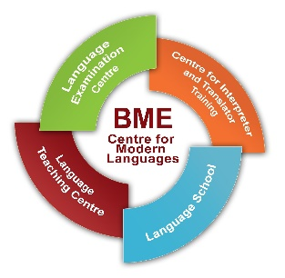

TSS 2020
ONLINE

Slide 2
How terminology work is organized at WIPO:
Introduction
Geoffrey Westgate, Cristina Valentini
Support Section, PCT Translation Division
TSS 2020 – 3 July 2020

Slide 3
Outline
What is WIPO
What is Terminology
WIPO Pearl
WIPO and Terminology Collaborations

Slide 4
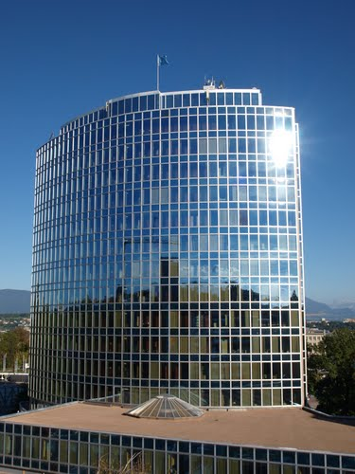
World Intellectual Property Organization (WIPO)
Specialized United Nations (UN) agency for intellectual property (IP)
Mission:
deliver global services for protecting IP
shape international IP rules
use IP for development
provide access to the world’s IP information

Slide 5
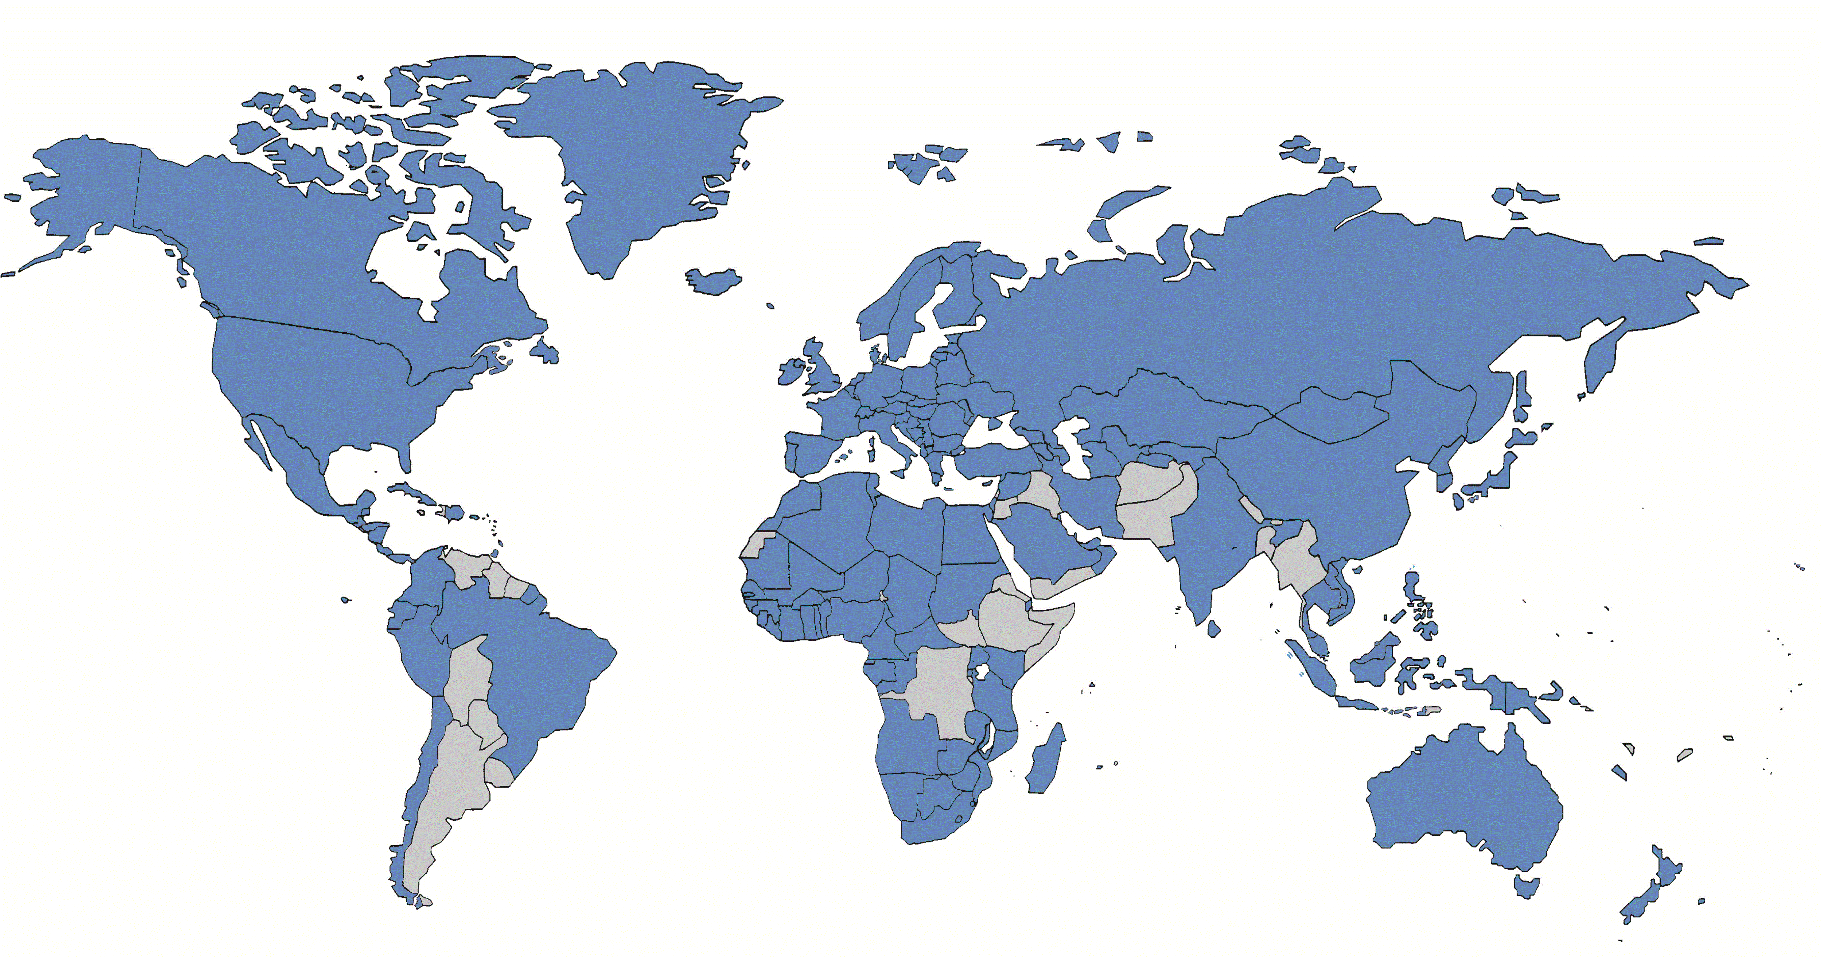
Patent Cooperation Treaty (PCT)
Treaty administered by WIPO
Unified procedure for filing patent applications in 153 countries
10 languages of publication
Improve access to patent information via PATENTSCOPE
Translation of
  patent titles and abstracts
  patentability reports
  treaty, rules, resources, website, etc.
Notes:
The 10 languages of publication are: English, French, Chinese, German, Spanish, Portuguese, Korean, Japanese, Arabic and Russian.
PATENTSCOPE is the WIPO’s database of patent applications (83 millions documents): it contains international patent applications filed via the PCT system and national patent collections, i.e. USPTO (USA Patent Office), EPO (European Patent Office), ROSPATENT (Russian Patent Office), etc. For a detailed coverage, see here: https://patentscope.wipo.int/search/en/help/data_coverage.jsf
Access to patent information is also granted by offering translation of patent titles and abstracts, patentability reports, and other PCT-relevant documents into English and French from one of the other PCT languages, which are also published in PATENTSCOPE and/or WIPO website.

Slide 6
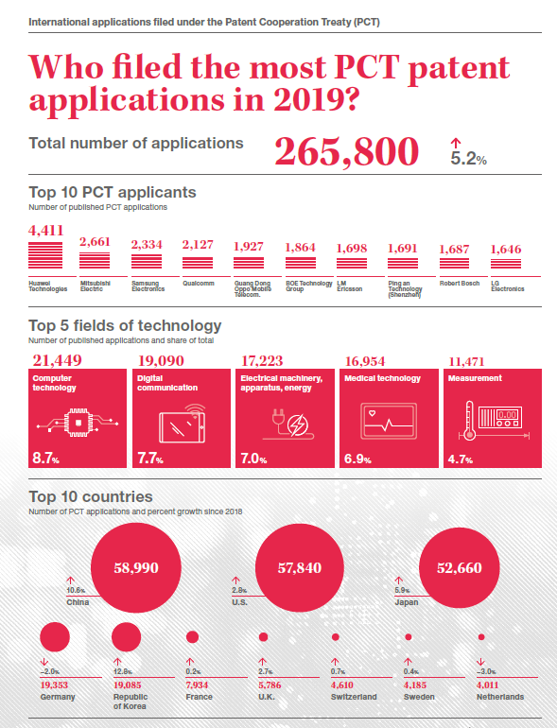
Source: WIPO, Infographics, 2020
Notes:
This is an overview of the filings in 2018. Amongst the main 10 PCT applicants we have companies of worldwide renown such as Huawei, Mitsubishi, Intel.
Regarding the top 5 fields of technology in which international applications are filed we find in first position digital communication followed by computer technology, electrical machinery, medical technology and means of transport.
Regarding the top 10 countries, the USA is the first country for number of filings, followed closely by Chinese, Japan, Germany and the Republic of Korea. Chinese, Japanese, German and Korean are accordingly the main languages from which we translate into English and French.
For an update on 2019, see here (just published!) https://www.wipo.int/pressroom/en/articles/2020/article_0005.html?utm_source=WIPO+Newsletters&utm_campaign=ad819a279a-EMAIL_CAMPAIGN_2020_04_06_08_20&utm_medium=email&utm_term=0_bcb3de19b4-ad819a279a-256069193

Slide 7

Learn more: WIPO Academy
WIPO Distance Learning Program:
  Introduction to the Patent Cooperation Treaty (free of charge, self-study, gives certificate, 4 hours; code PCT101E-DL-101)
  General Course on Intellectual Property (free of charge, tutored, gives certificate, 55 hours; code DL101E-DL-101)
  Coming soon: Introduction to Patent Terminology
  http://www.wipo.int/academy/en/

Slide 8
Translation and Interpreting at WIPO
Three Translation departments at WIPO
Language Division
  6 languages (UN official languages)
  Conference translation and Interpreting
Trademarks Division
  3 languages (EN, ES, FR)
Patent Division (PCT)
  10 languages (UN languages + 4)
  Translation, Terminology and Translation technology

Slide 9
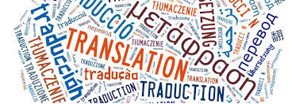
PCT Translation Division
Translation of abstracts and patentability reports from PCT patent applications
From: AR, DE, EN, ES, FR, JA, KO, PT, RU, ZH (10 languages)
Into: EN, FR
650,000 translations / 177 million translated words in 2019
In-house translators + outsourcing
CAT tools
AND: Terminology work

Slide 10
What is Terminology
Concept
Object
Term(s)

Slide 11

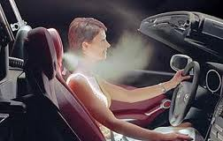
Example
< >
The concept
Characteristics:
- in a cabriolet
- in the headrest
- blows warm air
- for warming the neck
The object
The term(s)
- airscarf (EN)
- Nackenheizung (DE)
- Nackenfoehn (DE)
- Luftschal (DE)
- chauffage de nuque (FR)
- система Airscarf (RU), etc…

Slide 12

Lexicography vs. Terminology
Lexicography
Terminology
Joint
Concept 1
Concept 2
Concept 3
Concept 4
MEDI (grammar, etymology, usage) + equivalents
MEDI
EN (joint)
FR( Term)
ZH (Term)
(…)
MECH
EN (joint)
FR( Term)
ZH (Term)
(…)
PRNT
EN (joint)
FR( Term)
ZH (Term)
(…)
BLDG
EN (joint)
FR( Term)
ZH (Term)
(…)
MECH (grammar, etymology, usage) + equivalents
PRNT (grammar, etymology, usage)
+ equivalents
One word, one entry, multiple meanings
One concept, one record!
Notes:
Articulation ou joint selon le domaine
Lexicographie: on part du mot pour aller vers le sens (les acceptions) approche sémasiologique
Approche descriptive
Terminologie: on part du concept pour aller vers la désignation (mot ou terme) qui le décrit le mieux
Approche normative

Slide 13
Plastic lenses having substantially no optical power and a light-polarizing layer therein are prepared by shaping composite laminate of the light-polarizing layer (10) between opposed sheets of thermoplastic material (12, 14) by heating and pressing the laminate between opposed shaping molds (platens), the platens having predetermined radii of curvature for the production of a lens having substantially no optical power. The lenses are especially suited as sunglass lenses for spectacles.
WO/1995/008133

Slide 14
Special language in patents (1)
Disclosure
Protection
Need to disclose (describe) the invention so that it can be understood by a person skilled in the art
precise and accurate terminology
Need to obtain a broad scope of protection
vague and descriptive terminology

Slide 15

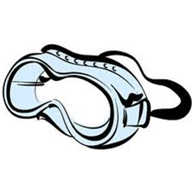

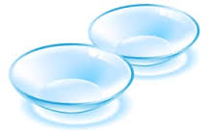

Special language in patents (2)
WO/2007/112308 Multifocal contact lenses
WO/2015/0866928 Spectacles associated with a hearing aid
WO/2012/162239 Material for eyewear and eyewear structure
US6848784 Eyeglass device having primary and auxiliary spectacle frames
US20030088241 Eyesight correcting apparatus
US20060103808 Eyesight improving device

Slide 16
PCT Terminology Work: What is it for?
Translation support (PCT Termbase via CAT tools)
translation consistency
translation quality
efficiency gains
cost reduction
and
Knowledge support (WIPO Pearl)
- LSP communication
- knowledge acquisition
- classification/indexation
- information retrieval
- data mining
Notes:
Accordingly, the PCT Termbase is used to optimize translation consistency, reduce costs related to time spent on researching the same term over and over again. It is primarily a translation support tool which is made available through the main CAT systems used by the PCT Translation Division. It is thus available to internal translators as well as external translators and agencies.
The aim of WIPO Pearl is somewhat larger, since it not only allows supporting translation but, given its wider audience, its aim is to enhance specialized language communication, acquisition and sharing of knowledge as well as imporving classification, indexation, information retrieval systems. WIPO Pearl is actually hooked up into PATENTSCOPE and specific queries for terms or combination of terms found in WIPO Pearl can be sent directly to PATENTSCOPE to retrieve patent documents that can be used in prior art search by patent drafters and patent examiners, for example.

Slide 17
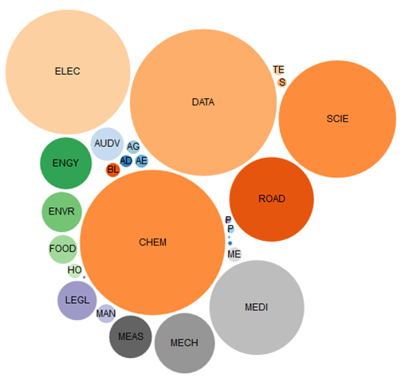
WIPO Pearl: Key features
High-quality
  Human-built
  Validated
10 languages
  45 language combinations
All fields of science and technology + PCT legal
Knowledge-rich
Concept-based

Slide 18
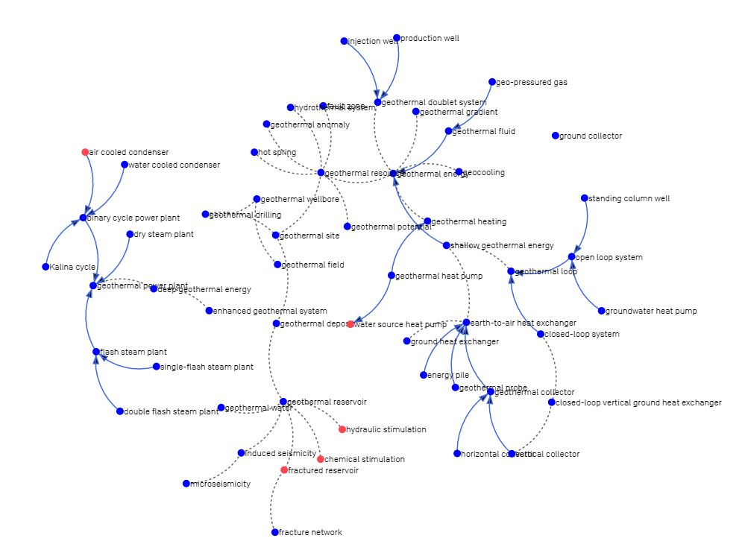
WIPO Pearl: Additional features
Reliability score for every term
Contextual information
Find terms in PATENTSCOPE
Find images for terms
Show relationships between terms (“concept maps”)
Generate AI-powered “concept clouds”
GUI in 10 languages

Slide 19


WIPO Pearl: Users
Language professionals: translators, interpreters, technical writers…
IP professionals: patent drafters, searchers, examiners, attorneys...
  Subject field specialists: research & development engineers, scientists…
Notes:
As mentioned earlier, accordingly, the audience of WIPO Pearl is much larger and it encompasses not only language professionals and IP professionals but also subject field experts.

Slide 20
















WIPO Pearl: Examples of users
Notes:
Here are some real users: national patent offices, governmental agencies, universities, private companies (PCT applicants) all around the world.

Slide 21
WIPO Pearl: Collaborations
  Collaboration with 20 universities worldwide for terminology record creation
  Collaboration with subject field experts for terminology record validation
  Collaboration with Terminology Standardization Division, Government of Canada
  Full list of partners: http://www.wipo.int/reference/en/wipopearl
Notes:
In WIPO Pearl it is possible to find a list of universities and bodies with whom we have a collaboration. Once we receive your terms, and after validation by our language experts, the name of the University of Auckland will also feature amongst our partners!

Slide 22
Terminology collaboration with Universities
Students deliver terminology projects for publication in WIPO Pearl
As Coursework or Masters dissertation
Collaboration projects with WIPO teach how to:
  scope a new terminology topic in detail
  deliver work for a client
  work according to guidelines
  work according to a timeline
  AND: it will be published in WIPO Pearl if good quality

Slide 23
WIPO-PCT Fellowship Program
  For terminologists, translators, CAT tools, and subject field specialists
Who?
  Recent Masters graduates in translation / terminology / CAT
  15-20 places per year
  Why?
  3-6 months work experience at WIPO
  When?
    2021 Program will be launched Jan 2021
    https://www.wipo.int/reference/en/wipopearl/news/2020/news_0001.html
Notes:
Terminology is a team endevaour: as said terminologists/translators/external contributors (pilots with two Universities)

Slide 24
Terminology is good for you! geoff.westgate@wipo.int cristina.valentini@wipo.int
Thank you very much for your attention

