Slide 1
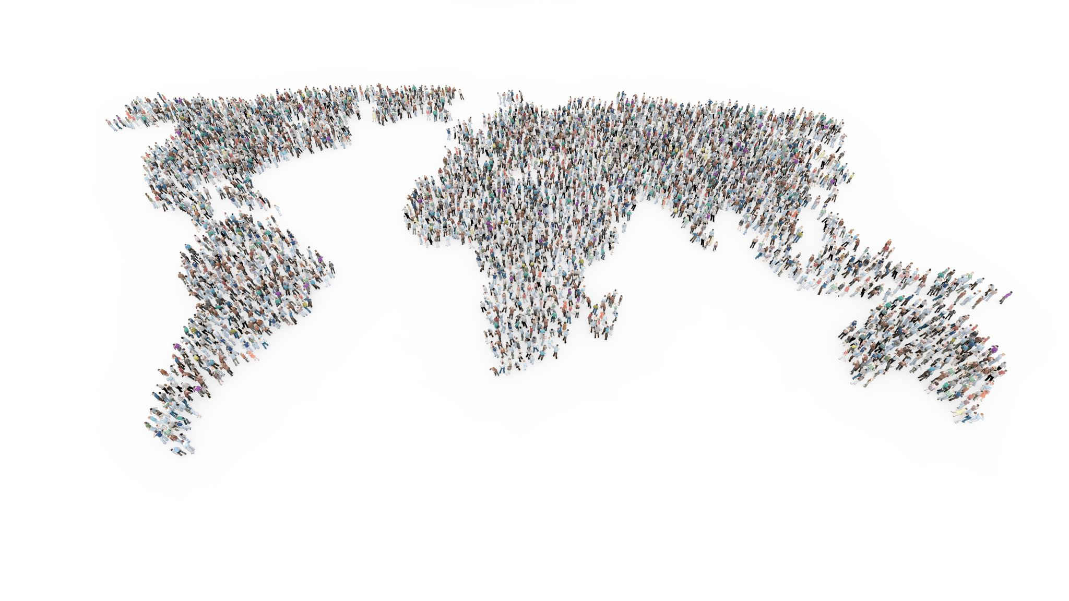
TSS 2020
ONLINE

Slide 2
How Terminology Work is organized at WIPO: Workshop
Geoffrey Westgate, Cristina Valentini
Support Section, PCT Translation Division
TSS2020, 3 July 2020

Slide 3
Methodology
Step 1: Choose a topic
Step 2: Build your corpus
Step 3: Select your terms
Step 4: Find good contexts
Step 5: Select eligible sources

Slide 4
Step 1- Choose a topic
Topic: Any subject matter of interest for scientific and technological innovation in patents
Subject field: An area of scientific and technical knowledge to which a concept is assigned in a classification: e.g. WIPO Pearl subject field classification

Slide 5
Step 1- Choose a topic: Examples
Geothermal energy (ENGY>Geothermal energy)
Biological control (AGRI>Biological control, Agrochemicals & pesticides)
T lymphocytes (SCIE>Genetics, Biology, MEDI)

Slide 6
Step 1- Choose a topic: Exercise 1
The topic of “virtual reality” is:
A good example of a topic to work on. It is an area of innovation of interest for patents.
A bad example of a topic to work on, because it is multidisciplinary, i.e. it spans different disciplines, e.g. artificial intelligence, robotics, electronics, multimedia tools and applications.

Slide 7
Step 1- Choose a topic: Exercise 2
The topic of "vehicles" is :
A good example of a topic to work on. It is restricted to a specific technical area, i.e. automotive engineering, which is highly relevant for patents.
A bad example of a topic to work on, because it is too broad and general. Vehicles are many and varied, e.g. airplanes, spacecrafts, boats, trains, cars, bicycles, scooters, and so on.

Slide 8
Step 2 - Build your corpus
In terminology, terms are extracted from corpora
A corpus is made of texts that are representative of a topic
A corpus is language-specific
Authoritative sources: Sources written by subject field experts who use correct terminology in their own native language

Slide 9
Step 2 - Build your corpus: Examples
Topic: “geothermal energy”:
Document:
https://en.wikipedia.org/wiki/Geothermal_energy
Topic: "telemedicine"
Document: https://patentscope.wipo.int/search/en/detail.jsf?docId=WO2018148594&_cid=P22-K9SI6J-43768-1

Slide 10
Step 3 - Select your terms
Key terms or state of the art technology terms that designate a concept in a scientific or technical field
Simple terms or complex terms
Nouns or noun phrases
Ineligible terms are: general descriptive terms, lone adjectives, other grammatical words (verbs, adverbs, etc.), set phrases, idioms, appellations, trademarks, and collocations
Frequency and relevance

Slide 11
Step 3 - Select your terms: Examples
Term candidate | Corpus Frequency | Eligible (Y/N) | Remarks
steering wheel | 1377.74 | Y | Noun phrase, well-established term in the field of automotive engineering - similar definitions exist in patent and non-patent literature, similar images found when researching the term.
steering system | 694.18 | N | General descriptive collocation. The word “steering” alone is the best designation to define the collection of components and linkages that allows a vehicle to follow the desired course, since its definition implies already the notion of “system, apparatus, set of components”.
electric motor | 319.91 | N | The term refers to a concept in the broader field of electrical engineering and is not specific to the field of automotive engineering field. See: https://wipopearl.wipo.int/en/fullrecord/4215

Slide 12
Step 3 - Select your terms: Exercise 1
"Rearing process" is an eligible term based on the following evidence:
"Cultivation of aquatic organisms typically involves enhancing production through some form of intervention in the rearing process, for example, regularly stocking a population, feeding a population, and protecting a population from predators”.
TRUE
FALSE

Slide 13
Step 3 - Select your terms: Exercise 2
Which one of the following set of terms would be eligible for inclusion in WIPO Pearl?
“Epidemiology”: direct contact transmission, indirect contact transmission, airborne transmission, communicable disease
“Dairy production”: milk, buttermilk, milk chocolate, milk serum
“Textile manufacturing”: snap button, warp, warping, warper

Slide 14
Step 4 - Find good contexts
The context should contain the term exactly as entered in the Term field, not another form of the term, e.g. not a multi-word term
The context should relate to the subject field/subfield selected
The context should come from an eligible source and be written by native speakers of the language in question, i.e. it is not a translation.
The contexts should preferably be defining

Slide 15
Step 4 - Find good contexts: Examples
Defining context: a context that contains substantial information helping you to understand a concept, but does not possess the formal rigor of a terminological definition.
“markup language”: https://wipopearl.wipo.int/en/fullrecord/15919

Slide 16
Step 4 - Exercise 1 Good or bad contexts?
SCIE>Geosciences : «valley glacier»
The geography of the world's water supply is changing. Many human occupied areas of traditional rainfall (i.e., the US Southwest) will receive less rain fall in the predicted weather change patterns caused by global warming, whether the source of the change is caused by humans or not. Many mountain-valley glaciers will shrivel or melt completely so that their summer melt rate will greatly reduce and/or will disappear completely.
WO/2011/013065

Slide 17
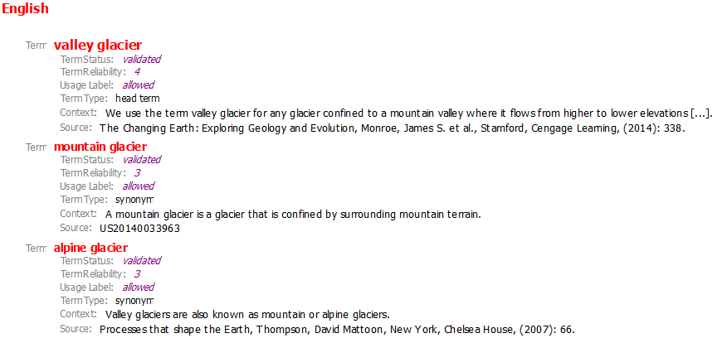
Step 4 - Exercise 1: Good or bad contexts?
SCIE>Geosciences : «valley glacier»

Slide 18
Step 4 - Exercise 2 Good or bad contexts?
MEDI> Dentistry : «crown»
The crown 112 may be defined as the upper curved portion of the head 102 of a wood or metal wood. The sole 114 may be defined as the bottom or underside portion of any type of club, and is generally opposite the crown 112.
US20160096083

Slide 19
Step 4 - Exercise 2: Good or bad contexts?
MEDI>Dentistry: «crown»

Slide 20
Step 5 - Select eligible sources
Source: any text in which a term occurs
Eligible sources: Patents (patent descriptions, preferably); Scientific and technical articles (e.g. published in specialized journals); Academic papers (theses, dissertations) and textbooks
Ineligible sources: Dictionaries, Glossaries, Encyclopedias, Terminology databases, Wikipedia, Blogs, Company websites

Slide 21
Step 5 - Select eligible sources: Examples
https://patentscope.wipo.int/search/en/detail.jsf?docId=WO2018183084&_cid=P20-KC5WDG-78444-1

Slide 22
Step 5 - Select eligible sources: Exercise 1
Eligible or ineligible source?
Contexts in English in the field of telecommunications: https://patentscope.wipo.int/search/en/detail.jsf?docId=WO2017101084&_cid=P10-KA78UZ-95410-1

Slide 23
Step 5 - Select eligible sources: Exercise 2
Eligible or ineligible source?
Contexts in English in the field of artificial intelligence: https://patentscope.wipo.int/search/en/detail.jsf?docId=WO2007042403&_cid=P10-KA78RA-94124-1

Slide 24
WIPO Pearl: https://www.wipo.int/reference/en/wipopearl/ geoff.westgate@wipo.int cristina.valentini@wipo.int
Thank you very much for your attention

