Slide 1




TSS 2020
ONLINE

Slide 2

Terminology Management — The Reviser’s Perspective
Edina Polácska PhD
Hungarian Office for Translation and Attestation Ltd

Slide 3
Programme
INTRODUCTION
TM Through Different Lenses
PART I — TM for a reviser
5-minute break-out session
Roles and workflows
Metadata
Good Morning! (?) – How to “make the bed” for our translator?
Terminological Preparations I — If time allows
Involve your client
Terminological Preparations II — Make use of the EU legislation
What would Forrest say?
PART II — TM in a CAT tool
Term extraction vs. manual labor
Quantity vs. Quality
How to store all those great terms we found
Summary and final thoughts

Slide 4

Introduction
Many years of “on-site” experience in the language industry mainly as reviser
Passionate but amateur (!) terminologist—with no institutional or theoretical background
Years in many different settings, each of them with a different approach to TM
Five layers, five approaches, through five lenses
My aim is to share what a reviser and his/her translator can do —hand in hand — to make their Clients smile and happy

Slide 5

Terminology Management – Through Different Lenses
Corporate (Bus manufacturing)
Technical specifications / User manuals of the buses in French
Travelled onsite (plant & assembly line)
Interviewed workers “How do you call in Hungarian this valve or that screw?”
Built TBs from scratch
EU (DGT, 1 year prior to Hungary’s accession)
Terminology work parallel with the translation of the Acquis
From scratch (“Term Inventors”)
Freelancer
Worked from what I got ☺ from the LSP
Head of Languages + Lead Terminologist at HU LSPs
TBs per Client, continuous TB maintenance & validation
Innovation, TB management, CAT tools
Current: Hungarian Office for Translation and Attestation
TBs organised per domain, deep and thorough terminology profiling

Slide 6
Terminology Management For a Reviser
“Process of documenting terms in a systematized and orderly fashion.” (https://www.languagescientific.com/terminology-management-why-it-matters/)
It can be:
As SIMPLE as creating a list of terms that appear in a text and their equivalents in the target languages
As COMPLEX as creating concept maps and diagrams of how terms are related to each other + defining attributes
Halfway: it is a list of terms and equivalents + definitions + examples of contextual usage
Ideally, TM should begin BEFORE a document is actually translated.
Since terms are the key to meaning in a technical text, documenting them upfront can help the linguist become even more familiar with the meaning of a text

Slide 7

Break-Out Session (5 min)
Why Bother With Termbases?
How could you convince a translator that building TBs is in his best interest?
Saves organisations > 20% on translation costs
  → Boosts efficiency + increases linguistic quality
Spares / Lessens Time
  → Eliminates “guesswork” for linguists → w/o TM: it would still take time to do research
Ensures consistency across all documents and all future projects for that same Client
  → It shows your client you are reliable and precise, and that you care about his text
Preserves Brand Identity
  → Better experience for both linguists and clients
It’s crucial that linguists are provided with the right tools that enable them to look up approved translations quickly and dynamically
  → Allows focusing on doing what they do best: translating

Slide 8
Why Bother With Termbases?
Minimize a delay in editing projects.
Reduce internal and external miscommunications.
Increase readability for the end user or reader.
Make it easier to update, replace, search or access term information across an entire organization.
Reinforce a professional company image and expertise within the field.
KEY FOR PROVIDING THE HIGHEST QUALITY

Slide 9
Roles and Workflows
Having a sound system of user roles is essential for creating standardized workflows that account for individual scenarios, such as:
Terminology validation process for new terms identified by content creators or customers
Terminology validation process for new terms identified by translators during the translation process
Process for managing terminology changes (maintenance TM & TB)

Slide 10
Metadata
Terms effectively useless without context
In my translation- (and Client) oriented approach: broader definition prevails → what the Client wants to have as a term
So a good terminology manager should provide for an appropriate set of specific metadata that go with each term.
These metadata — such as status, source, product, project, domain, date of entry, history and dates of changes as well as users — are critical for translators or terminology approvers.
They enable them to understand the context and history of individual terms so they can make informed decisions about their use.

Slide 11



Good Morning! (?) – How to “make the bed” for our translator?
“Morning Back Pain”
BAD QUALITY
A Translator With:
A Scanned or Hand Written PDF As Source File To Work On
No Translation Memory
No Alignments or Reference Documents
No CAT and Linguistic Support
No TERMINOLOGY at all (“Please search for yourself”)

Slide 12



Good morning! ☺
Wakes up happy
BOOSTED PRODUCTIVITY
GOOD QUALITY
A translator provided with:
properly prepared files to work on (OCR + .sdlxliff, .mqxlz etc.)
a Project TM to work in and a Master TM to look up in
reference documents aligned
permanent CAT and linguistic support
professionally compiled and maintaned terminology

Slide 13
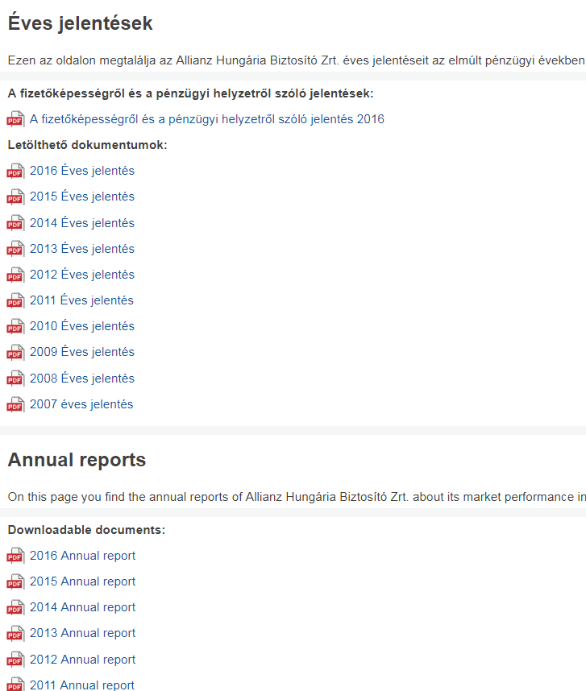
Terminological Preparations — If Time Allows
LET’S SIMPLIFY OUR WORK!
A well-prepared terminology shared with the translator → good benchmark for the reviser to stick to
Preparation step-by-step:
  Legal references / legislation mentioned in the footnotes?
  → Look up → Align → Import!
  Corporate Client’s Annual report 2020?
  → Remember: there is always a previous version!
  → Look up for Annual report 2019 or 2018
  → Align → Import

Slide 14
Involve your client
Inconsistency → confuse the reader and can make your translation look “sloppy” (terms → cornerstone of text cohesion)
COMMUNICATION is very important! (it is in his best interest)
Ask for old glossaries
Ask your client for their opinion → labelled as FEEDBACK
Check those glossaries and correct them if necessary – send them back to the client for feedback and approval
Send your client your word list proactively and give them a chance to change things

Slide 15
Terminological Preparations I — Make use of the EU Legislation
A Good Point to Start: The EU’s policies from Agriculture and Employment through Food Safety and Taxation until Human Rights and Single Market
Is your Requester:
A Pharma Company?
  Check for the relevant SmPC [Summary of product characteristics] / EPAR [European public assessment report] on the EMA’s website! (or: Google: „[name of the medicine]” + EMA + SmPC)
  Check Good Manufacturing / Good Clinical Practice (GMP / GCP) or Eudralex (collection of rules and regulations governing medicinal products in the EU) and make your own terminology extraction
  ICD codes (International Classification of Diseases)
An Insurance Company?
  Align the Solvency II Directive
  Look for EIOPA’s (European Insurance and Occupational Pensions Authority) Founding Regulation
A Railway Company?
  European Railway Agency’s (ERA) Founding Regulation
A Construction or Chemical Company?
  Align the REACH / CLP Regulation or go to ECHA Term, a Multilingual Chemical Terminology by the European Chemicals Agency (https://echa-term.echa.europa.eu/)

Slide 16
Terminological Preparations II — Make use of the EU Legislation
Is your text for translation:
HR-related?
  Check out the EU’s Staff Regulation → Align → Import
  Your country’s Labour Code and its translation into your 2nd language
About Aviation?
  Check out the EASA’s (European Union Aviation Safety Agency) Founding Regulation
About Banking Transactions?
  Check out the EBA’s (European Banking Authority) or the ECB’s (EU Central Bank) Founding Regulation
About OSH (Occupational Safety and Health)?
  Look up for the Founding Regulation of the EU-OSHA (European Agency for Safety and Health at Work)
An Extract From Trade Register?
  For the main scope of activities, rely on the NACE Classification (statistical classification of economic activities in the European Community)

Slide 17
RECAP: Terminological Preparations
Identify the domain or topic your Client is active in
Classify it under the relevant EU policy
Map the corresponding EU agency or body (see webpage of the Translation Centre for the Bodies of the EU).
For example:
  Medicines, Pharmaceuticals → European Medicines Agency (EMA)
  Gender Equalities → European Institute for Gender Equality (EIGE)
  Data Protection → European Data Protection Supervisor (EDPS)
  Migration → FRONTEX
  Adult Education → Cedefop
  Food industry → EFSA

Slide 18
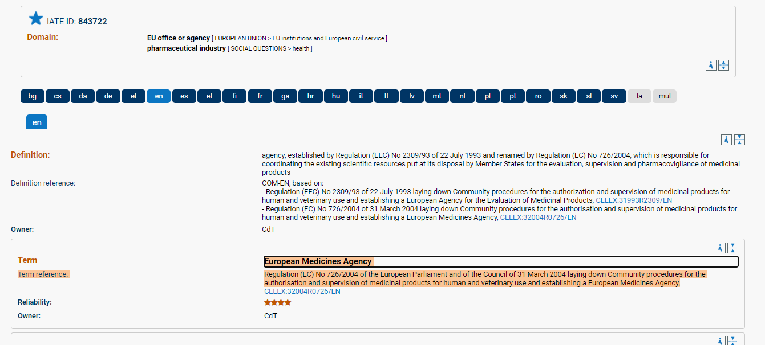
RECAP: Terminological Preparations
Go to IATE and search the Agency then for the Founding Regulation (“….establishing…”):
Go to EUR-LEX (or google), download the desired language versions, align and import
GO THE THE “DEFINITIONS” SECTION AND HARVEST TERMINOLOGY (along with definition)

Slide 19

EU Term? General Term?
But Be Aware — Some terms are only applicable in the EU context!
Ex.: Entrepreneurship:
EU context: skill (Unternehmergeist, esprit d'entreprise)
general context: company (Unternehmertätigkeit, entrepreneuriat)
The Choice Is Yours!

Slide 20
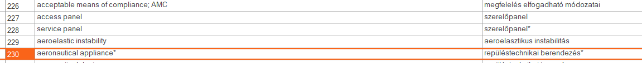
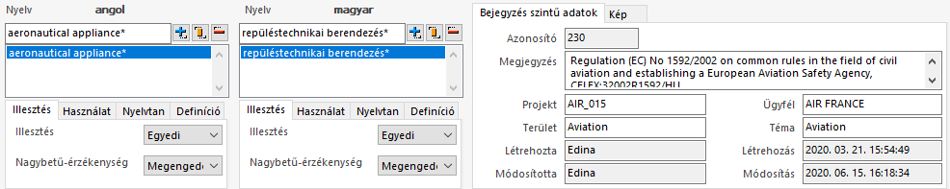
RECAP: Terminological Preparations
Benefits:
Translator and Reviser sticking to the same database (no debate)
If Complaint → Credible & Unquestionable Source of Terminology
Time Efficient → No More “Guesswork” For The Translator

Slide 21


What Would Forrest Say?
“My Mum has always said to me: [A translator’s] life should be like a box of chocolates.
They should always know what they’re gonna get.”
For the sake of the highest quality, our translator’s “box of chocolate” should include:
Original file for information
Bilingual file (.mqxlz, .sdlxliff etc.)
Master TM to look up in (CONCORDANCE!!)
Project TM to work in
References aligned
Master TB to rely on
Working TB to gather terms into
Relevant terms harvested beforehand

Slide 22

Part II - Terminology Management in a CAT tool
Term extraction vs. manual labor
Quantity vs. quality
How to store all those great terms we found
How to add “forbidden terms” and use QA checks to spot inconsistent translation

Slide 23
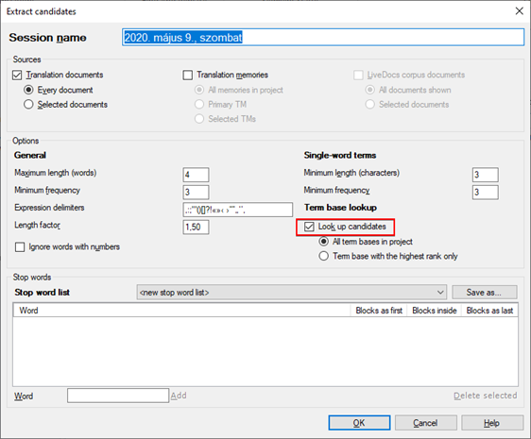
Term extraction
Term Extraction: harvesting possible terms from documents, TMs, and other relevant corpora.
We may need this when we prepare a project for translation, or when we need to build a term base as part of a project.

Slide 24
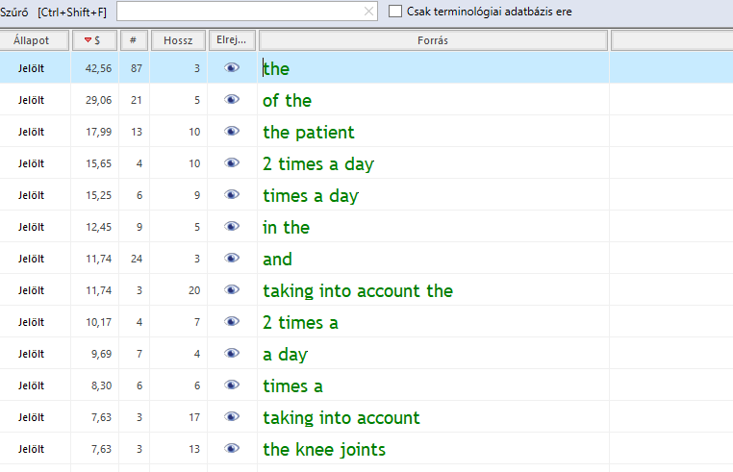
Term extraction: example of irrelevant term

Slide 25
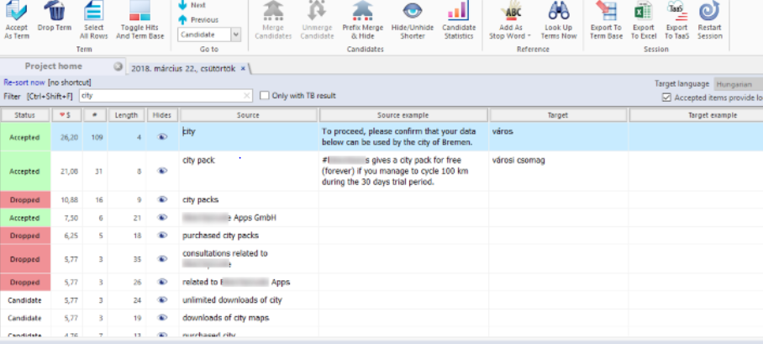
Final steps

Slide 26
Term extraction vs. manual labor
The old-fashioned way also has its merits
What are good terms?
  Terms that have many possible meanings
  Terms that have many different synonymes, but I choose one and should stick with it (TERM = BROAD APPROACH)
  Terms I had to research.
  ANY TERM my client wants to read in his translated texts.

Slide 27
Quantity vs. quality
The trick is not quantity but quality.
Although it is not really a hindrance to have a bunch of unused terms in my termbase, there is no need for that.
A good term base might also only have three terms in it, but if they refer to the client’s main product, we have better get them right – even next year.

Slide 28

How to store all those great terms we found
Classic dilemma:
  by client?
  by specific subject (education, finance, agriculture, pharma)?
  by group of fields (social sciences, technical, economics, health sciences)?
  or one single TB for several clients from the same field (UNIQA, Allianz, Metlife, Generali)?
How to structure the terms?
  only one source term at a time?
  only one equivalent at a time?

Slide 29
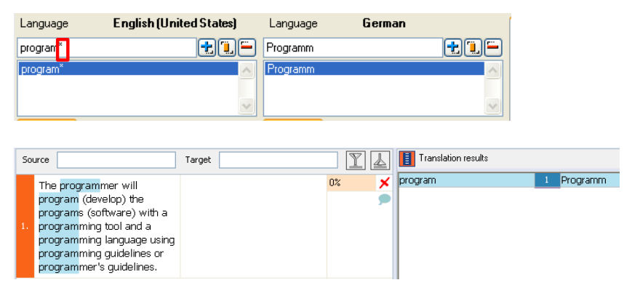
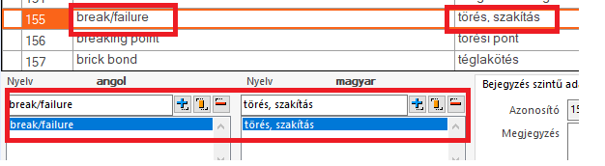
Termbase structure
Once you have two variants for a term, do not add these with a slash or a comma but separately, otherwise this will mess up your QA results!
(TERM AUTONOMY)
Also: wildcards and pipes are very important!

Slide 30

Add as “Watch Out” Terms
Has your Client corrected one of your favourite terms and you want to avoid it to be used again?
Or do you have a term that you think is not worth being listed as you would translate it automatically but your Client wants to have a different equivalent for that?
Examples:
Academic titles (Dr. Mag.)
Names of institutions (Companies House in the UK)
Language variants (Jänner – Januar, Erdäpfel – Kartoffeln / Portmonnee – Geldbeutel)
Corporate jargon you would automatically translate
  Vice President should remain Vice President in HU, forbidden: alelnök
Terms that your Client had already corrected
It helps both new Translator’s work (if any) and QA
(will be spotted)

Slide 31
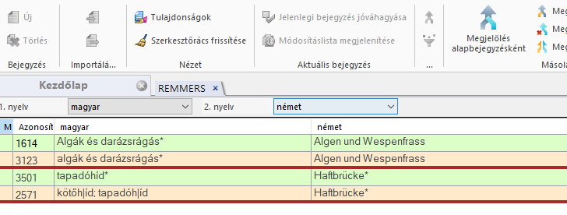
Maintenance
Clean your termbase regularly
Fix spelling mistakes of target terms only
Paradoxically: source terms should be entered with grammar mistakes ☹ (some Clients are not as good at grammar or punctuation… → NO TB HITS
Delete duplicates

Slide 32

SUMMARY: Our goal as reviser should be…
(1) Always provide:
a “box of chocolate” for our translators
a reliable source for the term (IATE, EUR-LEX, Celex #, Client’s webpage, Client feedback, “validated by Client” etc.)
(2) Make sure there is a paradigmatic shift in our Translator’s mind from looking up in dictionaries towards terminology-based approach BUT in a translation-oriented mindset (see: BROADER APPROACH) (definition, reliable source, context, status etc.)
(3) Make them understand that the termbase is NOT a dictionary and should not be used as such

Slide 33

In exchange our translator should…
  Always think before inserting → Definition? Domain? Context? – even the DATE! – are very important to consider
  Watch out for polysemy
    Example: policy (HU):
    politika (politics)
    szakpolitika (EU)
    kötvény (insurance)
    szabályzat, eljárás (corporate lingo)
  Focus on text cohesion + avoid synonyms

Slide 34
THANK YOU FOR YOUR ATTENTION
polacska.edina@offi.hu

