Slide 1
Terminology and Intellectual Property Rights
Christian Galinski, Infoterm (based on presentations in the past developed together with) Inke Raupach

Slide 2
Overview:
Terminology?
Recent cases
Introduction to IPR (see also: http://www.wipo.int/copyright/en/about/)
What does „copyright“ mean?
Legal bases
What is protected by copyright?
Terminology as subject to copyright
Translation memory (TM) and copyright
New developments and solutions
2

Slide 3
Terminological entry
Conforming to international standards
[SOURCE: ISO 10241-1:2011]
DESIGNATIVE
3.4.1.1.5
graphical symbol
visually perceptible figure with a particular meaning used to transmit information independently of language
[SOURCE: ISO 7001:2007, 3.1.]
EXAMPLE Graphical symbol “recyclable” with two variants:
DESCRIPTIVE
DESIGNATIVE
synonym
3

Slide 4
Microlearning object example Learning object: Kanji Flashcard: 「休」
Front side: kanji, examples and additional information➔
⬅Back side: lexems, pronunciation, meanings and additional information
Source: Whiterabbit kanji flashcard
Also: distinction between PRIMITIVES and COMPOSITES

Slide 5
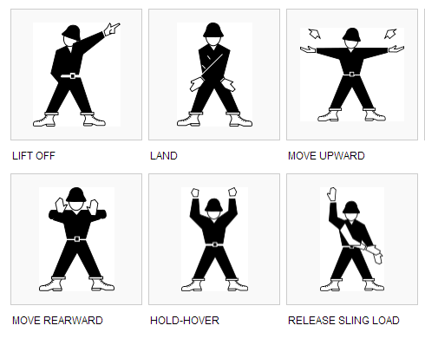
Non-verbal representation: Helicopter marshalling signals
DESCRIPTIVE
DESIGNATIVE

Slide 6
Terminology database
Data categories (metadata)
Structure (datamodel)
Primary data (microcontent)
6

Slide 7
Case 1: Disclaimer
The Europeana.eu website is run by the Europeana Foundation and gives access to a wide range of digitised cultural heritage from across Europe and beyond.
This material is provided to Europeana by a large number of contributing institutions and organisations. Europeana strives to make all resources on this website available for re-use.
As part of this, all metadata (textual information on digitised cultural heritage) on the site are published without any restrictions on re-use.
Most other material, such as the previews to digitised cultural heritage, is clearly labelled with rights statements that indicate if and under which conditions it can be re-used.
Necessary/useful/sufficient?
7

Slide 8
Case 2: Suppression of copyrighted items
A lawyer detected in WebTerm ONE (=1) photo (for which a relative of a photographer had inherited the author‘s rights) among tens of thousands of terminological entries from diploma or master theses, and sued the TH Köln (University of Applied Sciences, Cologne) in court.
http://www.iim2.fh-koeln.de/webterm/
WebTerm Terminologiesammlungen aus Diplomarbeiten an der Fachhochschule Köln Hinweis: Bilder und Grafiken der terminologischen Einträge wurden aus Urheberrechtsgründen enfernt!
(NOTICE: Pictures/photos and graphic representations were removed due to reasons of originators‘ rights)
8

Slide 9
Case 3: Removal of a graphic representation
A student of Vienna University
who wanted to submit in digital form
a doctoral thesis comprising terminological aspects
had to remove a graphical representation
because the creator of that representation did not approve
the reuse (quotation) of the representation
from a published book
WHY?
9

Slide 10
Case 4: (fictive) risk with dialogue data
Speech corpora – especially predetermined sequences of spoken dialogue – are more likely to be subject to copyright than ordinary text
Data in dialogue databases may also be protected under the EU Directive for the legal protection of databases
The use of spoken dialogue (e.g. by visually impaired persons) and transcribed spoken dialogues (for other persons with disabilities, PwD) may risk to be interdicted, even if not infringed deliberately
BIZARRE?

Slide 11
Case 5: automatic Wikipedia entries
Certain ICT tools which search the Internet – especially blogs – can automatically generate rudimentary Wikipedia entries
As automatically generated “content“ they are not protected by CR … the software may be protected!
However, what about thousand of such automatically generated entries? – can they be regarded as a database?
This is reality! ;-)

Slide 12
Case 6: protection under trademark
CATS – Computer-Aided Terminology System
CATS® is a registered trademark of Univ.-Prof. Dr. P. A. Schmitt (Leipzig) und M. Schultze-Griebler (Dresden)
CATS™ is a musical composed by Andrew Lloyd Webber, based on Old Possum's Book of Practical Cats by T. S. Eliot, and produced by Cameron Mackintosh © 1986 Really Useful Group Ltd. | All Rights Reserved
Both are available on CD-ROM
→the CR owners of the CATS software were accused of IPR violation

Slide 13
Case 7: Content identification technologies
Dilemma for rights owners:
Too many risks & possibilites for users to infringe copyright
New marketing and business opportunities
Tracking content for tracing CR infringement is difficult
Internet Service Providers (ISP) are more and more legally required to inhibit CR infringement
If CIT are applied in the US → limitations of liability might be lost
Endless spiral: → new technology → new laws or other regulations → new technology … always implying benefits for some and disadvantages for others

Slide 14
Case 8: „Share“ button on Facebook
Facebook user was fined 1.000 Euro for sharing the photo of a sports champion (23.03.2015)
Blogger, online media, Internet users: all under risk
Photo shared without explicitely mentioning the ‘originator‘ viz. a cameraman taking the picture
Anyone in the chain from the ISP – via distributor – to the user can be made liable

Slide 15
Break-out: marking microcontent entities chose one of the 6 questions numbered (2)~(7)
Unique identification of the resource/microcontent entity:
…
(2) Indication of position of copyrighted element in the resource
- Where and how?
(3) Indication of time of use/retrieval
- What time, where and how?
(4) Indication of copyright relevance
- How, where and why?
(5) Indication of kind of license (in coded form)
- How, where and why?
(6) Indication of use conditions (in coded form)
- How, where and why?
(7) Nanopayment
- How and what would be necessary?
(1) resource ID | (2) slot | (3) time stamp | (4) IPR y/n | (5) licence | (6) use conditions

Slide 16
Copyright and IPRs in general
Copyright
belongs to a family of
intellectual property rights (IPR)
and related/neighbouring rights
16

Slide 17
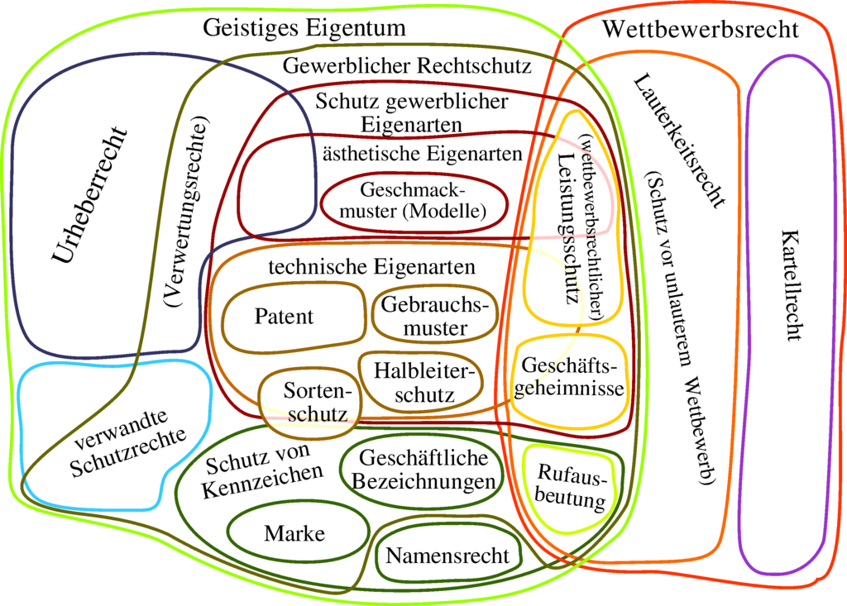
IPRs and related/neighbouring rights 1
http://de.wikipedia.org/wiki/Geistiges_Eigentum
17

Slide 18
IPRs and related/neighbouring rights 2
NEW related right:
Sui generis right
on the legal protection of databases
18

Slide 19
TM = database?
Collection of independent elements AND
a substantial investment
Astrid Cruse, Starnberg
19

Slide 20
TM = database work?
Collection of independent elements AND
a personal intellectual creation
(in terms of the content or structure of the database)
Astrid Cruse, Starnberg
20
Notes:
Auswahl: Sichten, Sammeln, Bewertung und Zusammenstellen unter Berücksichtigung bestimmter Kriterien.
z.B.: Texte zur Rechnungslegung, Gesetze zu einem bestimmten Themengebiet
Anordnung: nicht die physische Anordnung auf Datenträger. Es genügt, dass die Datenbank aufgrund entsprechender Abfragemöglichkeiten einer Ordnung zugeführt werden können
z.B.: TM kann nach vergebenen deskriptiven Attributfeldern geordnet, exportiert und neu sortiert werden.

Slide 21
What does copyright mean?
Copyright is a set of exclusive rights regulating the use of a particular expression of an idea or information (http://en.wikipedia.org/wiki/Copyright)
/Copyright/ (=author’s/originator’s right) is the exclusive right of an author/originator to his/her work (http://de.wikipedia.org/wiki/Urheberrecht)
2 different concepts of “author’s right”:
“copyright” in Anglo-American law
“droit d’auteur” / “Urheberrecht” in continental European law
21

Slide 22
Copyright as a stimulus for progress
COPYRIGHT
intended as stimulus for artistic creation and scientific research in order to
ensure wide distrib-ution of the results of intellectual works in order to
promote scientific, social and intellectual progress
22

Slide 23
Terminology as subject to IPR – I
Not protected/protectable:
Information
Ideas
Knowledge
Text below a certain threshold – e.g. a definition
Protected/protectable:
Representations and presentations of knowledge
Texts (and other kinds of content above a certain threshold)
!Non-linguistic representations!
Databases (containing linguistic and non-linguistic data)
23

Slide 24
Terminology as subject to IPR - II
Terminology resources can comprise:
terminological data proper, such as
linguistic data (terms, abbreviations, symbols, definitions, other kinds of explanatory texts, etc.) – trade marks? word-design mark?
non-linguistic data (graphical symbols, images, complex graphs, logos etc. to which different copyright provisions and other IPRs can apply)
associated information
24

Slide 25
Terminology as subject to IPR – III
Do the following constitute copyright or some other IPR?
concepts
terms
proper names (√) (esp. if trademark/logo protected)
definitions etc.
definitions proper
explanations? (√)
citations, defining contexts, … (√)
other kind of concept description (√)
pictures √
formulae (√)
graphical representations (√)
25

Slide 26
Exploitation rights
Comprise the right of
Reproduction
Performance to the public
Translation, adaptation, other alteration
Using and distributing altered versions of the work
Distribution (in general)
➔ Collective rights management & CR collecting societies/agencies
26

Slide 27
Limitations and exemptions
Reuse of data without permission and royalties
Quotation
Private purposes
Illustration for teaching or research
Public security
Administrative or judicial procedure
Anglo-American law: “fair use”, “fair dealing”
→ of course there are activities to restrict these limitations/exemptions
27

Slide 28
Digital rights management – DRM
Past: main obstacles to terminological data exchange:
No/inconsistent use of harmonized data categories
No application of standards-based data model
No application of commonly used classification scheme, references to sources of information etc.
Today: new obstacles to web-based cooperation (WRT data exchange and distribution):
“volatility” of Internet sources
Different types of links → surface-links vs. framing
Different copyright on individual content items
Minimum DRM functions have become imperative
28

Slide 29
Approach to a DRM solution 1
Unique identification of the resource:
Conventional publications: (macrocontent)
ISBN, ISSN, ISAN, ISTC, ISWC, …;
DOI: ISO 26324:2012; ISLI: ISO 17316:2015, …;
Individual data (microcontent):
ISO/TS 29002-5:2009 Industrial automation systems and integration – Exchange of characteristic data – Part 5: Identification scheme
Indication of position of copyrighted element in the resource
Indication of time of use/retrieval
Indication of copyright relevance
Indication of kind of license (in coded form)
Indication of use conditions (in coded form)
➔ alternative option: use Creative Commons (CC)
(1) resource ID | (2) slot | (3) time stamp | (4) IPR y/n | (5) licence | (6) use conditions
29

Slide 30
Approach to a DRM solution 2
Unique identification of the resource:
Conventional publications:
ISBN, ISSN, ISAN, ISTC, ISWC, …;
DOI: ISO 26324:2012; ISLI: ISO 17316:2015, …;
Identification of individual data (in databases):
ISO/TS 29002-5:2009 Industrial automation systems and integration – Exchange of characteristic data – Part 5: Identification scheme
CCF (Concept Coding Framework) http://www.conceptcoding.org/ (aiming at accommodating the needs of persons with “communicative functioning (dis)abilities”)
ISO 17316:2015 “Information and documentation – International standard link identifier (ISLI)” → include other microcontent entities?
Besides, there are many codes and coding systems, with IDs for each code element (some even standardized)
➔ alternative: use Creative Commons (CC) license system
30

Slide 31
Break-out: Finding solutions
31

Slide 32
Break-out: marking microcontent entities chose one of the 6 questions numbered (2)~(7)
Unique identification of the resource/microcontent entity:
…
(2) Indication of position of copyrighted element in the resource
- Where and how?
(3) Indication of time of use/retrieval
- What time, where and how?
(4) Indication of copyright relevance
- How, where and why?
(5) Indication of kind of license (in coded form)
- How, where and why?
(6) Indication of use conditions (in coded form)
- How, where and why?
(7) Nanopayment
- How and what would be necessary?
(1) resource ID | (2) slot | (3) time stamp | (4) IPR y/n | (5) licence | (6) use conditions
32

Slide 33
References:
NEW!!!
Cruse, A.; Fürlinger, M.; Galinski, Ch.; Raupach, I.; Schmitz, K.-D. Copyright for terminological data.
In: Drewer, P.; Pulitano, D.; Schmitz, K.-D. (eds.). Terminology work. Best practices 2.0. Köln: Deutscher Terminologie-Tag e.V., 2020. Modul 7, 16 p. ISBN 978-3-9812245-5-9

Slide 34
34

Slide 35
References:
http://www.copyright.com/Services/copyrightoncampus/content/digital.html
http://en.wikipedia.org/wiki/Copyright
http://en.wikipedia.org/wiki/Universal_Copyright_Convention
http://en.wikipedia.org/wiki/Creative_Commons
GALINSKI, Christian and WRIGHT, Sue Ellen. Copyright and terminology. In: Sue Ellen WRIGHT and Gerhard BUDIN, comps. Handbook of terminology management. Vol. 1: Basic aspects of terminology management. Amsterdam/Philadelphia: John Benjamins, 1997, pp. 281-302
GALINSKI, Christian and GOEBEL, Jürgen W. Guide to Terminology Agreements. Vienna: International Network for Terminology (TermNet), 1996, 7+35 p.
GALINSKI, Christian and Inke Raupach and Klaus-Dirk Schmitz. Standard document templates and procedures. Deliverable D2.2 of the EU-Project EUROTERMBANK (Collection of Pan-European Terminology Resources through Cooperation of Terminology Institutions), 2005 (published 2006)
CRUSE, A.; Fürlinger, M.; Galinski, Ch.; Raupach, I.; Schmitz, K.-D. Urheberrecht an Terminologie [Copyright for terminological data]. In: Drewer, P.; Pulitano, D.; Schmitz, K.-D. (eds.). Terminologiearbeit. Best Practices 2.0 [Terminology work. Best practices 2.0]. Köln: Deutscher Terminologie-Tag e.V., 2014. Modul 7, 16 p.

Slide 36
International law – Development
1886: Berne Convention for the Protection of Literary and Artistic Works
1952: Universal Copyright Convention (UCC) developed by UNESCO as an alternative to the Berne Convention
1994: Agreement on Trade Related Aspects of Intellectual Property Rights (TRIPS) negotiated at the end of the Uruguay Round of the General Agreement on Tariffs and Trade (GATT) is administered by the World Trade Organization (WTO)
1996: WIPO Copyright Treaty and WIPO Performances and Phonograms Treaty (WPPT)
+ EU Directives
➔ Complementarity and subtle differences in terms of
Implementation at national level + different legal practice
NEW: Translatlantic Trade Investment Partnership TTIP ➔ CETA

Slide 37
WIPO Copyright Treaty
World Intellectual Property Organization Copyright Treaty
Adopted in 1996
Adds issues raised by ICT and Internet to the Berne Convention
Art. 4: computer programs are protected as literary works
Art. 5: protection covers the arrangement and selection of material in databases

Slide 38
Authors‘ rights vs. Copyright
FR: Droit d‘auteur (1791-1793)
DE: Urheberrecht (1870/1871)
Emphasises creativity
Originator = natural person
Registration not required
Difference: moral rights and exploitation rights
Only exploitation rights can be transferred
UK: Statute of Anne (1709)
US: Copyright Act (1790)
Emphasises business
Natural or legal persons can own copyright
Registration not absolutely required
Copyright comprises exploitation rights
Copyright can be transferred

Slide 39
EU Directives
96/9/EC on the legal protection of databases
2000/31/EC on certain legal aspects of information society services in particular electronic commerce, in the Internal Market
2001/29/EC on the harmonisation of certain aspects of copyright and related rights in the information society
2004/48 EC on the enforcement of intellectual property rights
➔ Implementation at national level + different legal practice

