Slide 1
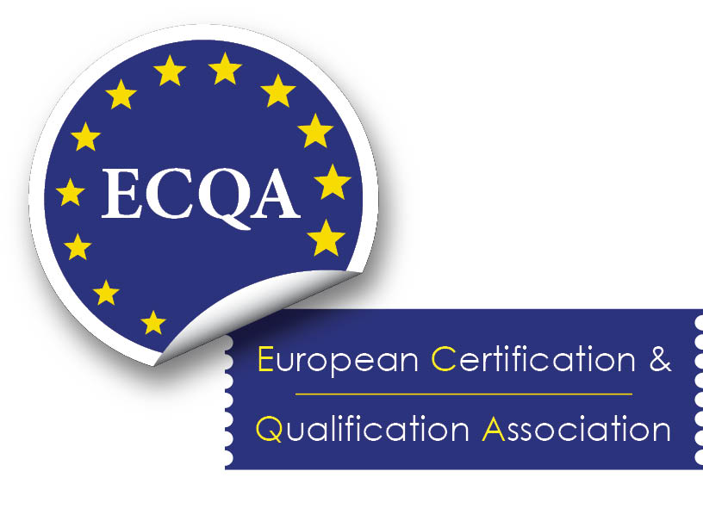
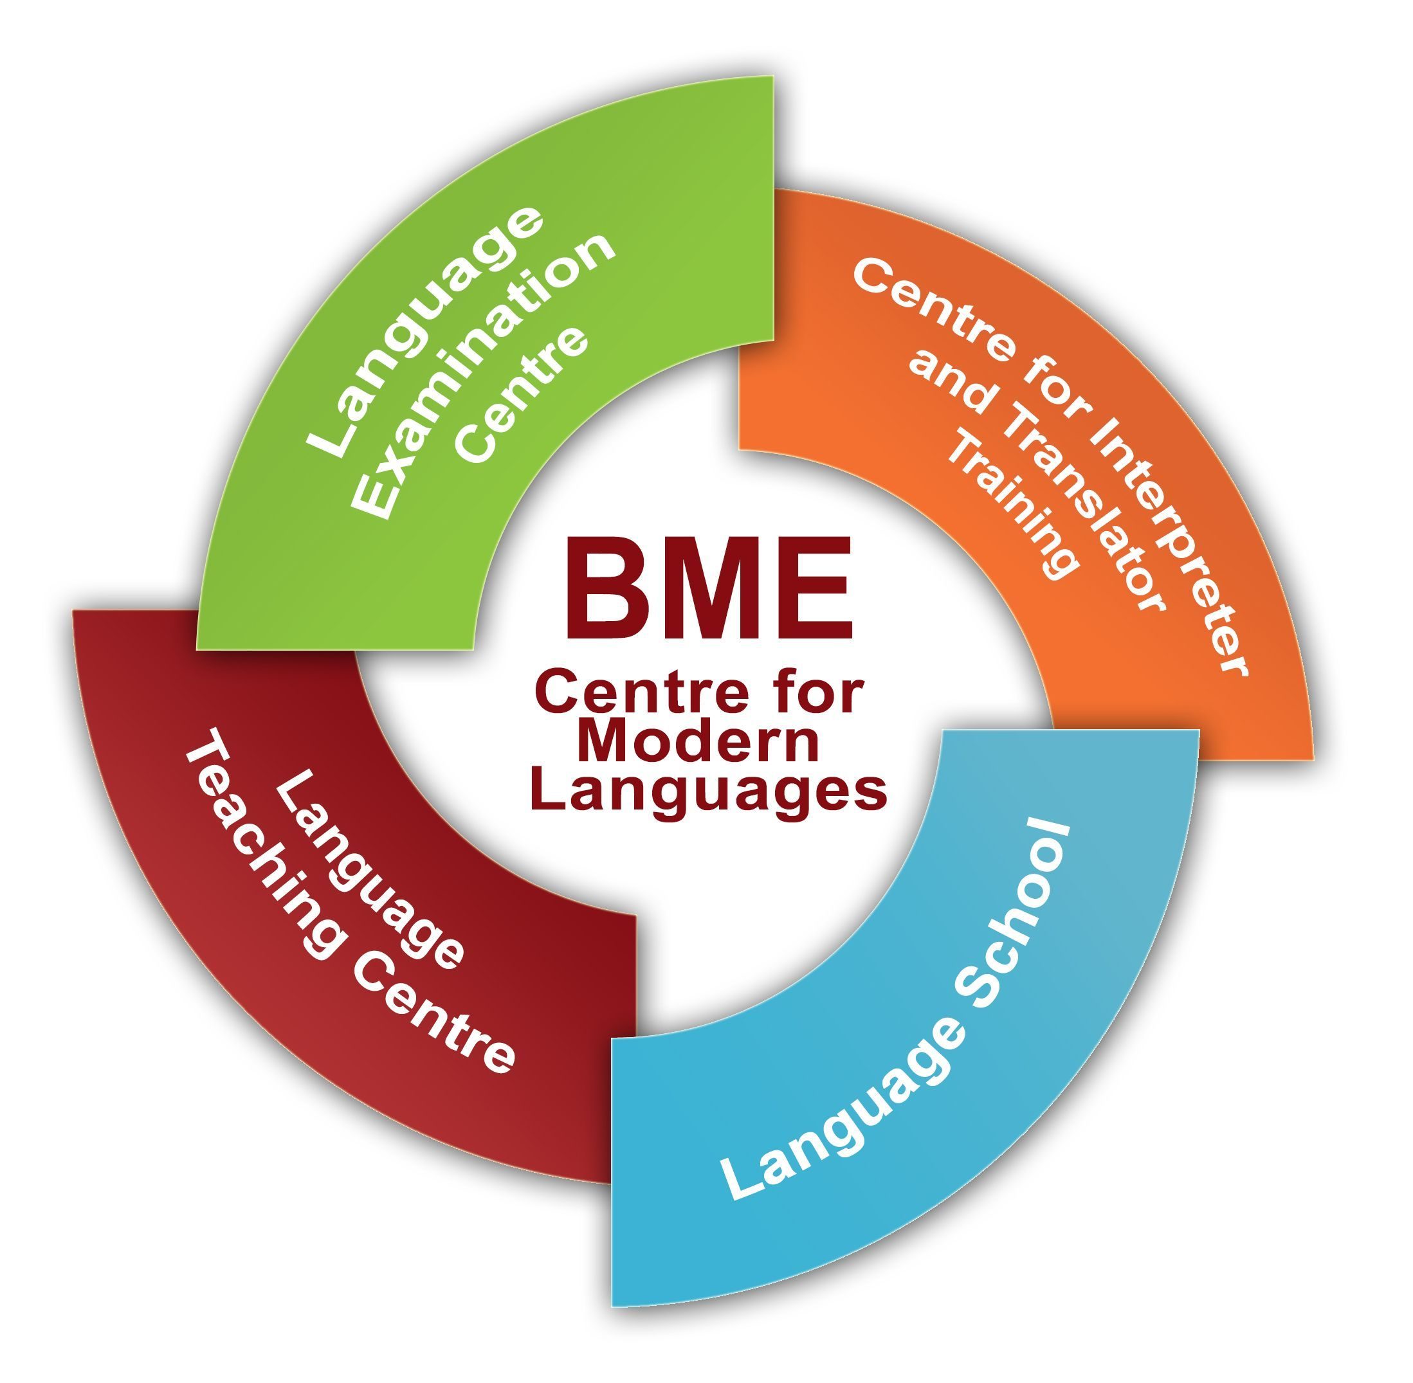
TSS 2020
ONLINE

Slide 2
Post-editing of Machine Translation Output for translators and terminology professionals
Day 2 -Workshop 1: Gabriele Sauberer, LICS Lead Auditor

Slide 3
Warm up
10 Min. Break out session:
What are/could be the GOOD things about post-editing of MT output?
Present your findings, with a view to terminology

Slide 4
New: LICS Certificate
Machine Translation Editor according to ISO 18587
1 Scope
This certification scheme specifies the criteria and the procedure to certify the competence of a person with regards to her/his knowledge and skills in the area of machine translation (MT) post-editing.

Slide 5
New: LICS MT Editor ISO 18587
2 Competence requirements
Persons certified according to this scheme are competent to assess the quality and to edit machine translation output in accordance with ISO 18587.
Persons certified are able to improve texts and to produce a proper target language content from existing machine translation output.

Slide 6
New: LICS MT Editor ISO 18587
2.2 Requirements for knowledge and skills
Persons certified in accordance to this scheme shall have the following knowledge and skills:
2.2.1 Translation competencies
Persons certified are capable to
• recognise and deal with problems of language content comprehension and language content production
• render target language content in accordance with the client-translation service provider (TSP) agreement and the TSP-post-editor agreement

Slide 7
New: LICS MT Editor ISO 18587
2.2.2 Linguistic and textual competencies
Persons certified shall
• be fluent in both, source- and target language
• have at least general knowledge of text-type conventions and in accordance to this,
• be able to produce texts and other target language content.

Slide 8
2.2.3 Research competencies
Persons certified shall
• be able to acquire additional linguistic and specialised knowledge to understand source language content and produce target language content,
• have experience in the use of research tools and
• be able to develop strategies for the efficient use of information sources available.

Slide 9
2.2.4 Domain and cultural competencies
Persons certified shall
• be able to understand and master the domain content produced in both, the source- and target language.
• have the knowledge of and the ability to make use of information on behavioural standards, value systems and to
• be able to localise and deal with both as well in the source as in the target language.

Slide 10
2.2.5 Technical competencies
Persons certified shall
be able to perform the technical tasks in translation processes,
employ technical resources including tools and IT systems to support translation processes,
have at least general knowledge of MT technology,
have a basic understanding of common errors produced by MT systems,
have at least general knowledge of computer-aided translation tools,
be able to follow instructions received and to focus on specific issues to make corrections as given,
be able to provide structured feedback on frequently recurring errors in MT output,
have at least a general understanding of the interaction between terminology management systems and MT systems.

Slide 11
3 Prerequisites for admission to the exam (1/2)
The following options shall be met by the candidate:
either accomplishment of a course concerning the topics of MT post-editing based on the content of section 2 (2.5 ECTS, workload: 60hrs)
or hands-on experience in the field of MT post-editing of at least 3 years.
Plus, one of the following prerequisites:
proof of professional experience in the field of translating,
a higher education degree in translation, linguistics or language studies (or equivalent) including significant translation training or
a higher education degree in any other field plus proof of professional experience in the field of translating or post-editing for at least two years.
be able to perform the technical tasks in translation processes,
employ technical resources including tools and IT systems to support translation processes,

Slide 12
3 Prerequisites for admission to the exam (2/2)
Plus, one of the following prerequisites:
have at least general knowledge of MT technology,
have a basic understanding of common errors produced by MT systems,
have at least general knowledge of computer-aided translation tools,
be able to follow instructions received and to focus on specific issues to make corrections as given,
be able to provide structured feedback on frequently recurring errors in MT output,
have at least a general understanding of the interaction between terminology management systems and MT systems.

Slide 13
Break-out session 15 Minutes
Do a research in the Internet (www.ecosia.org) about:
Which Standards or Guidelines about MT post-editing are available online?
Which MT post-editing courses are available?
Present your findings in the panel

Slide 14
MT post-editing is a new service for translation and terminology professionals
gsauberer@termnet.eu

Slide 15
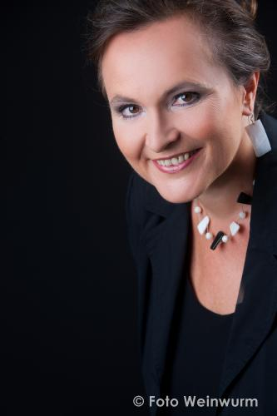
Who am I?
Gabriele Sauberer
Director, International Network for Terminology
Managing Partner, TermNet Business GmbH & TermNet Americas Inc.
Vice President, ECQA
YOUR CONTACT FOR TSS2020 and ECQA
Launched ECQA Certified Terminology Manager and LICS (the Language Industry Certification Systems) together with Austrian Standards
Certified quality auditor and expert in standardization committees for Terminology, Translation and Diversity Management
Gabriele Sauberer
Director, TermNet – International Network for Terminology Director, TermNet Business GmbH
Vice President Processes, ECQA

