Slide 1


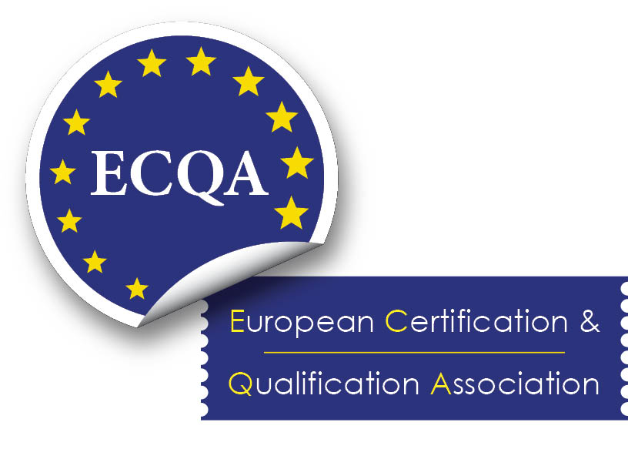
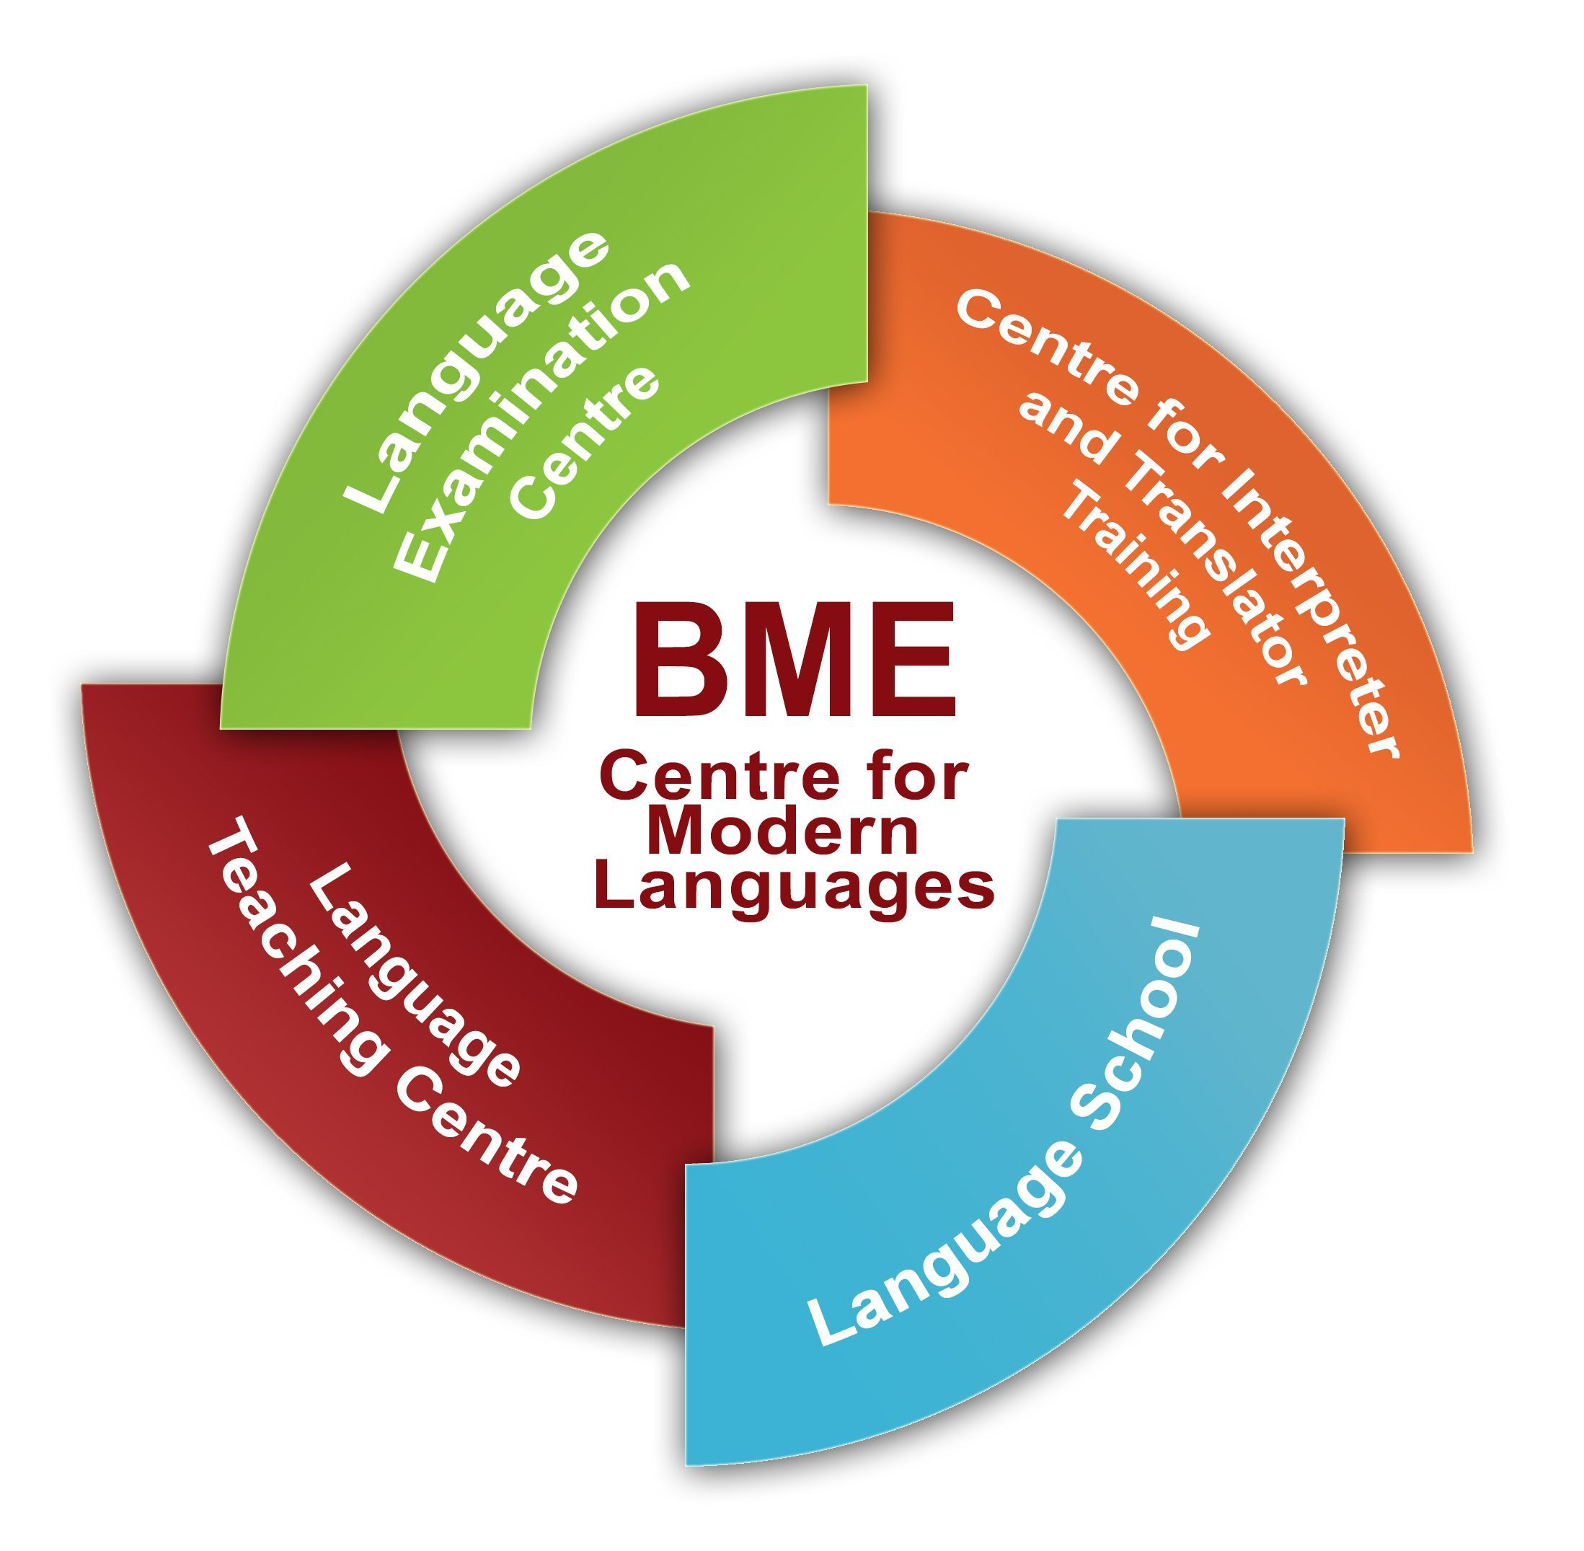

TSS 2020
ONLINE

Slide 2
Terminology and Machine Translation: Post Editing of Machine Translation Output
Gabriele Sauberer, ISO 18587 Lead Auditor

Slide 3
Warm up
5 Min. Break out session:
What is your experience with MT output so far?
Did you ever do post-editing of MT output?

Slide 4
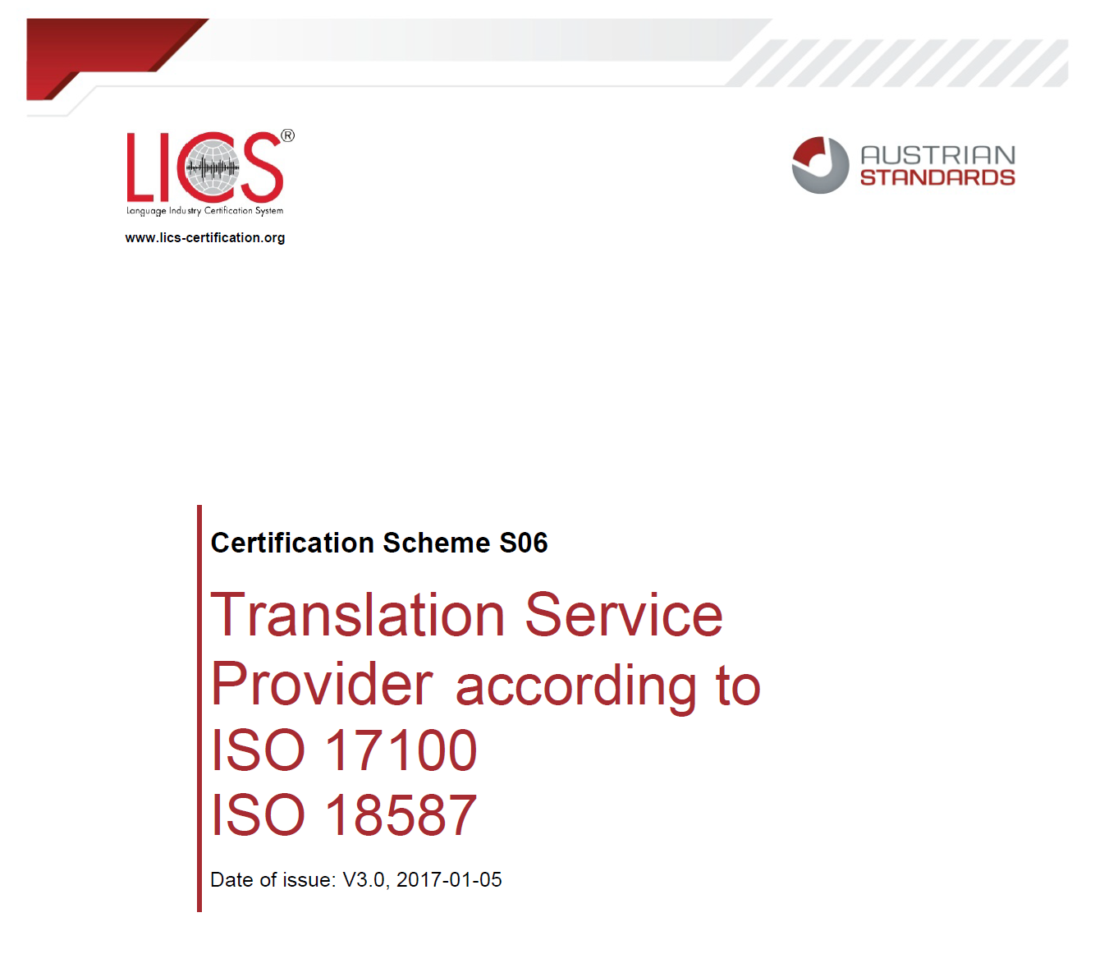
We will work with this Certification Scheme
→ Handout

Slide 5
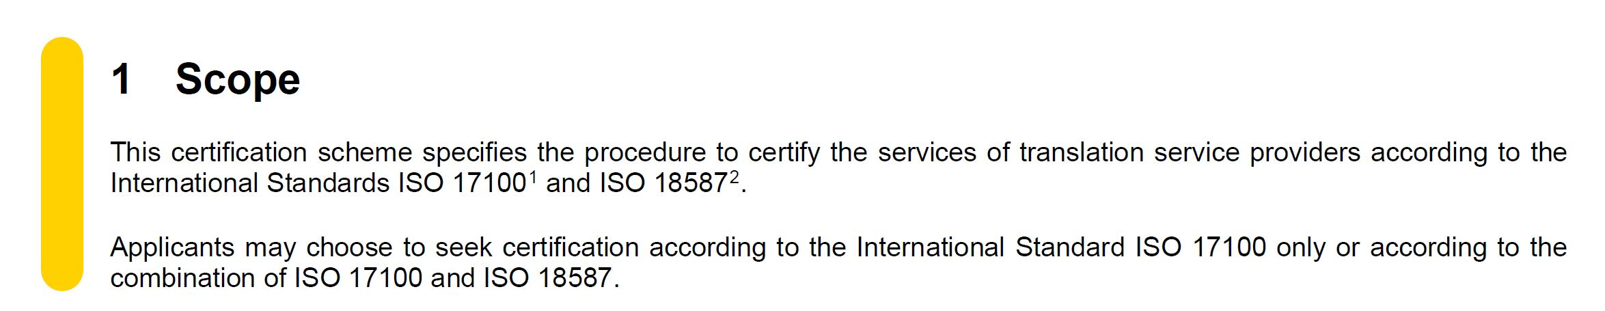

Slide 6
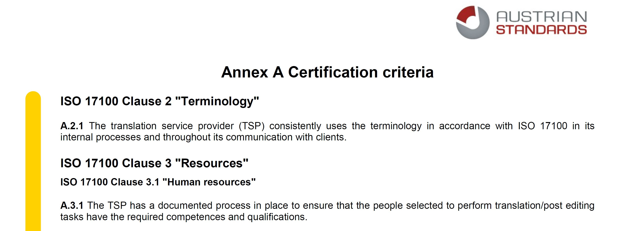

Slide 7
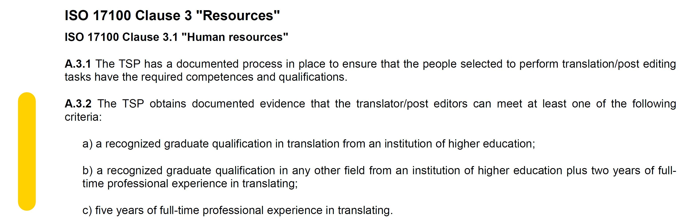

Slide 8
Auditing ISO 18587 together with ISO17100
Post-editors of MT output shall have the same skills and competences as translators

Slide 9
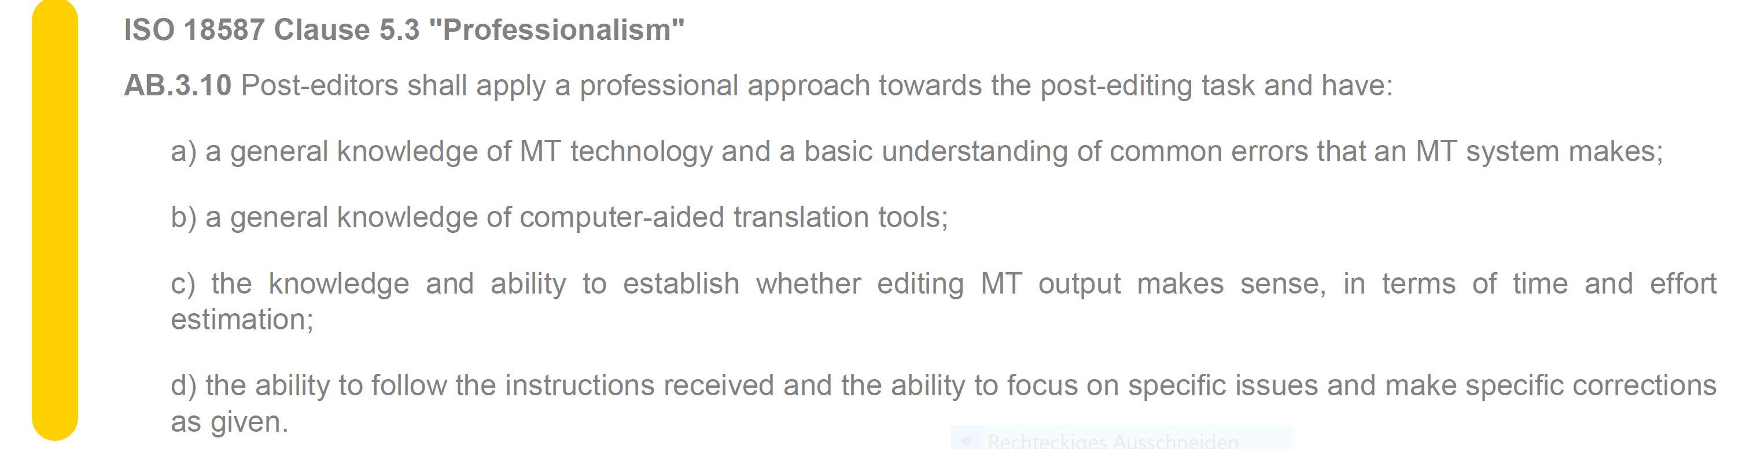

Slide 10
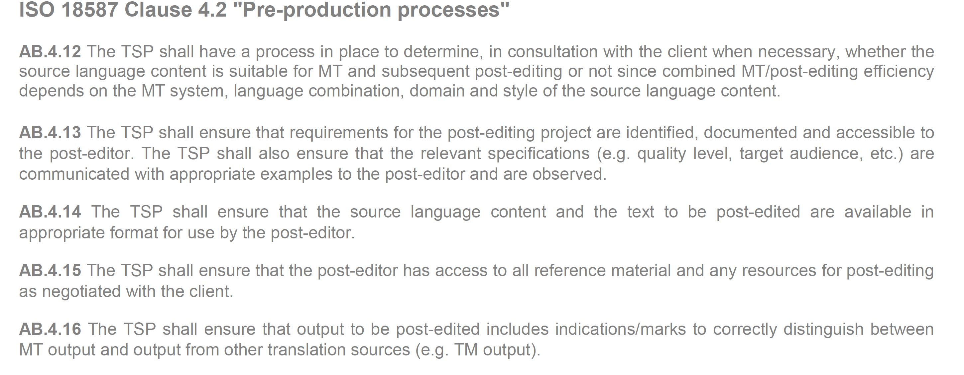

Slide 11
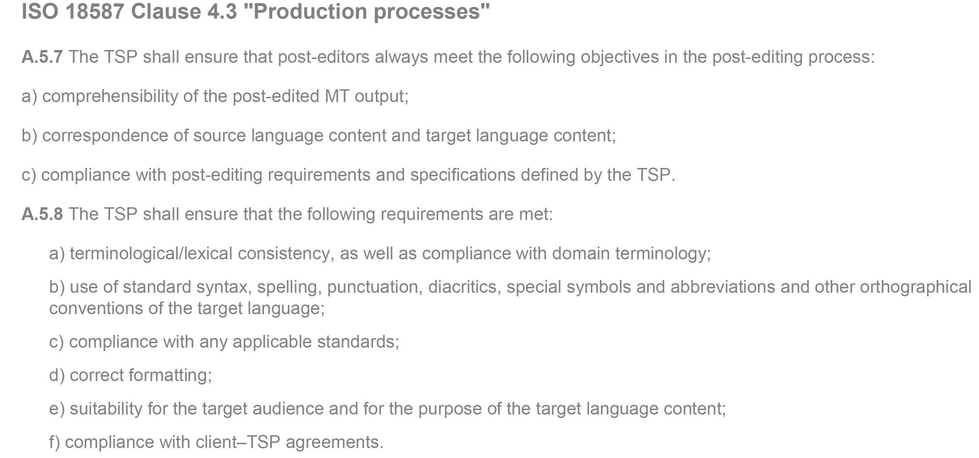

Slide 12
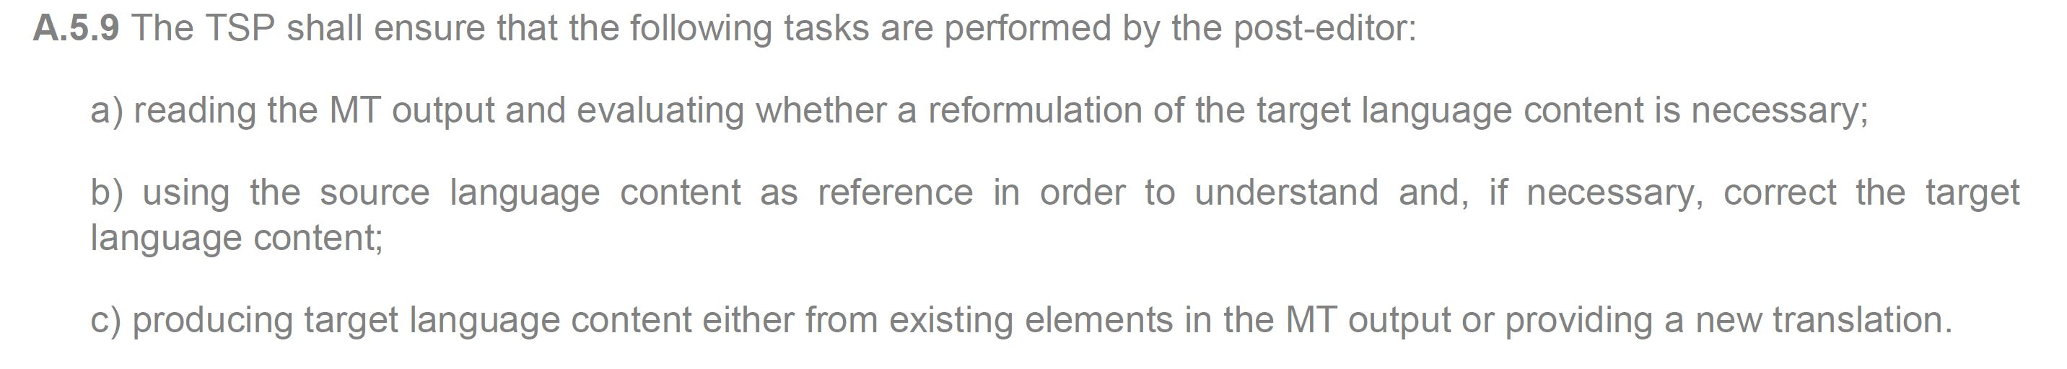

Slide 13
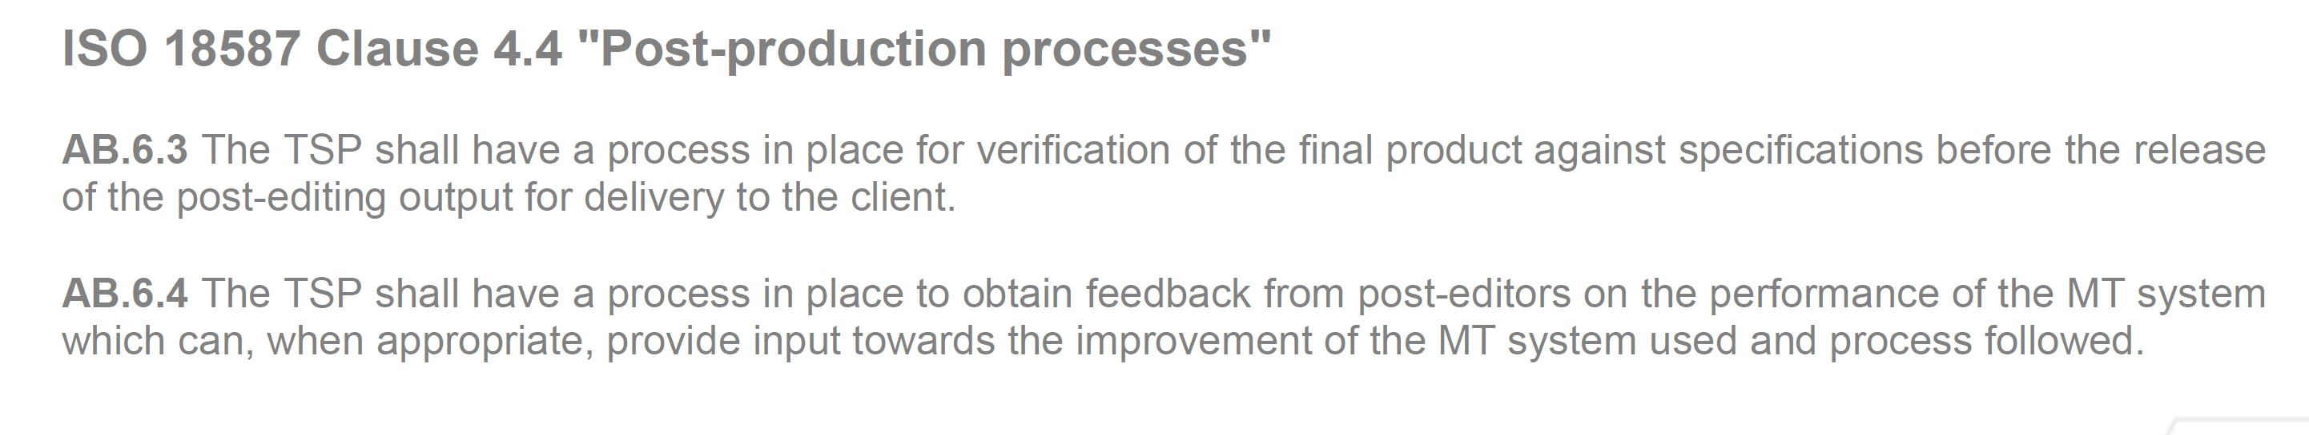

Slide 14
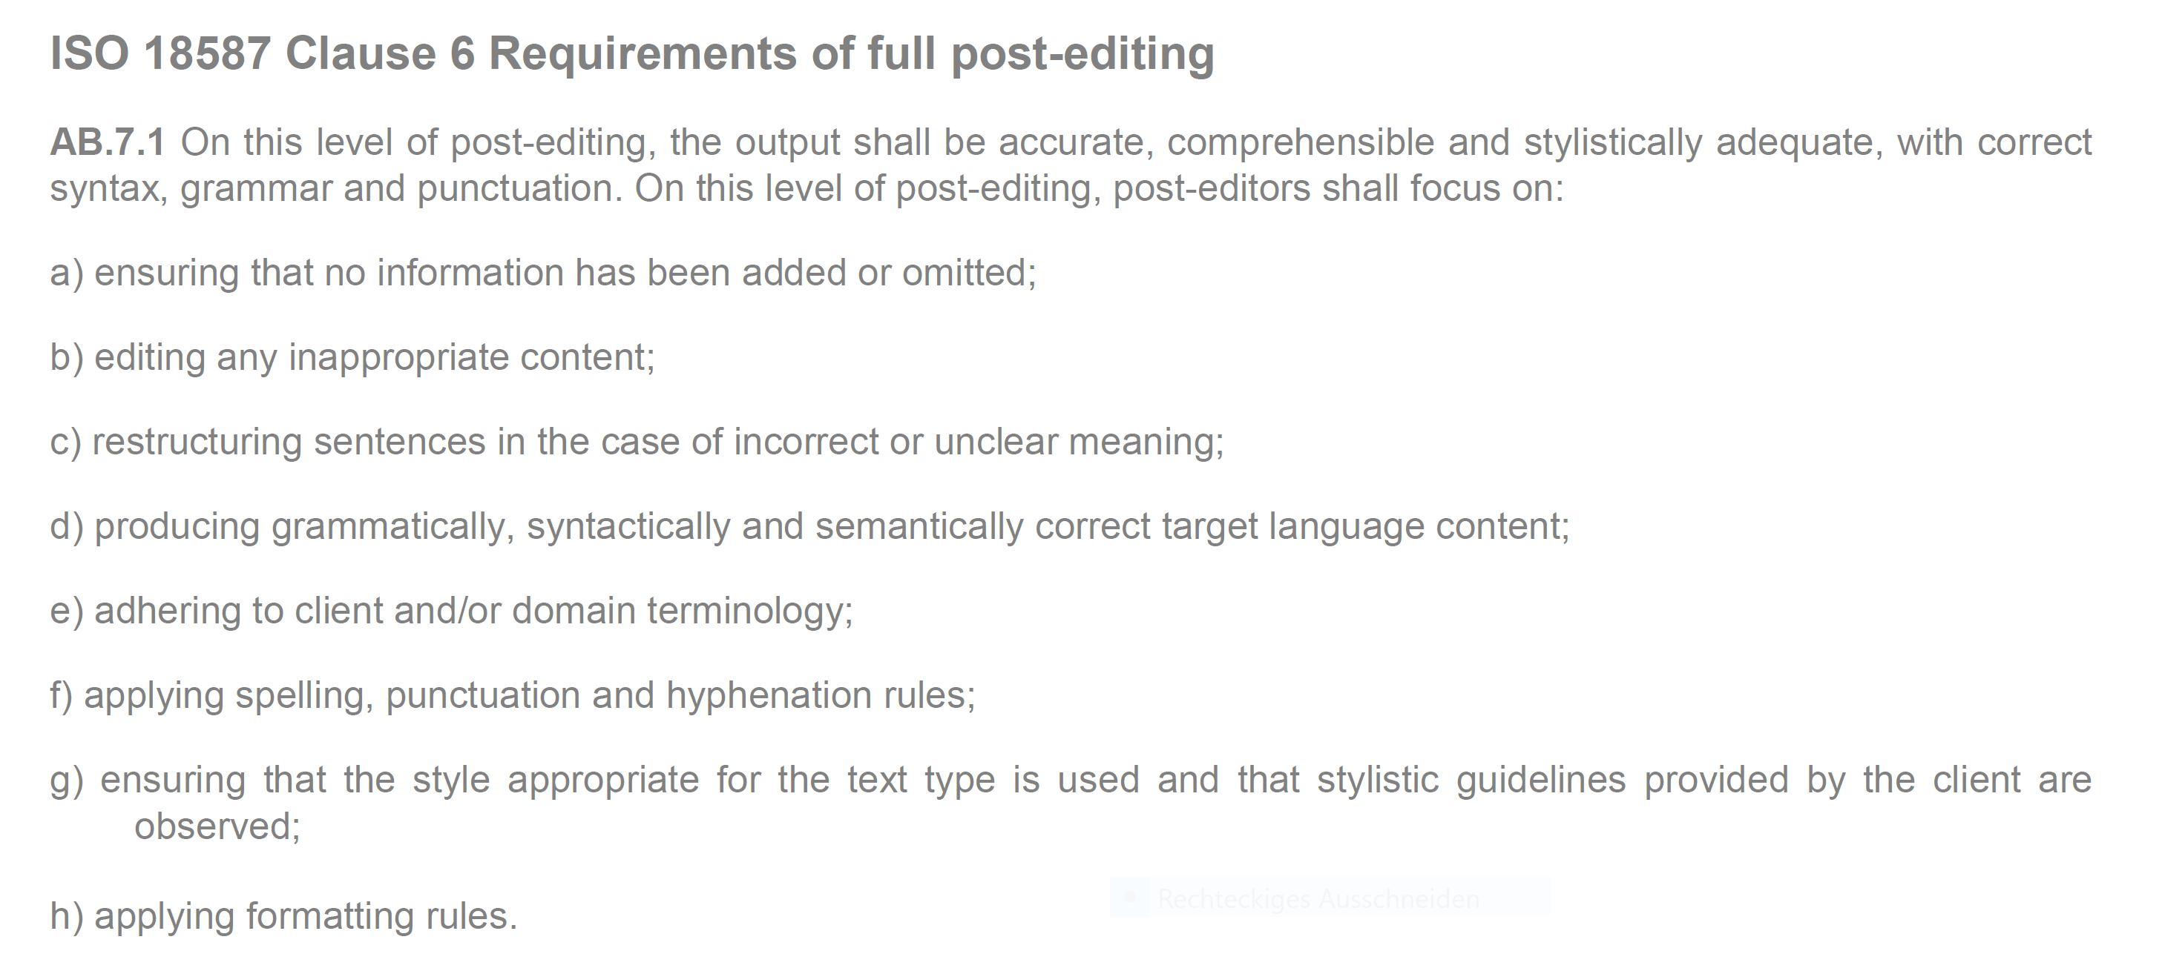

Slide 15
Auditing ISO 18587 together with ISO17100
Post-editing processes of MT output are similar to human translation processes, in particular within „full post-editing“

Slide 16
Experience as an Auditor of ISO 18587
MT is highly relevant for all of us
Post-editing of MT is not boring, but interesting and challenging (AI)
Creativity of translators is needed – also regarding negotiating good fees for post-editing services
Translation Memories make MT post-editing fast and efficient
Terminology needs to play a crucial role – so far almost ignored – in the tools!

Slide 17

Open your mind for MT – Try out post-editing
Improve the quality of MT through terminology
gsauberer@termnet.eu

Slide 18
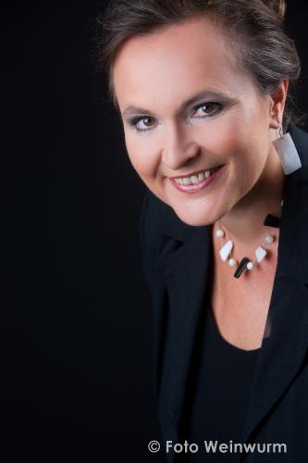
Who am I?
Gabriele Sauberer
Director, International Network for Terminology
Managing Partner, TermNet Business GmbH &
TermNet Americas Inc.
Vice President, ECQA
YOUR CONTACT FOR TSS2020 and ECQA
Launched
ECQA Certified Terminology Manager and LICS (the Language Industry Certification Systems) together with Austrian Standards
Certified quality auditor and expert in standardization committees for Terminology, Translation and Diversity Management
Gabriele Sauberer
Director, TermNet – International
Network for Terminology
Director, TermNet Business GmbH
Vice President Processes, ECQA

